Slide 1
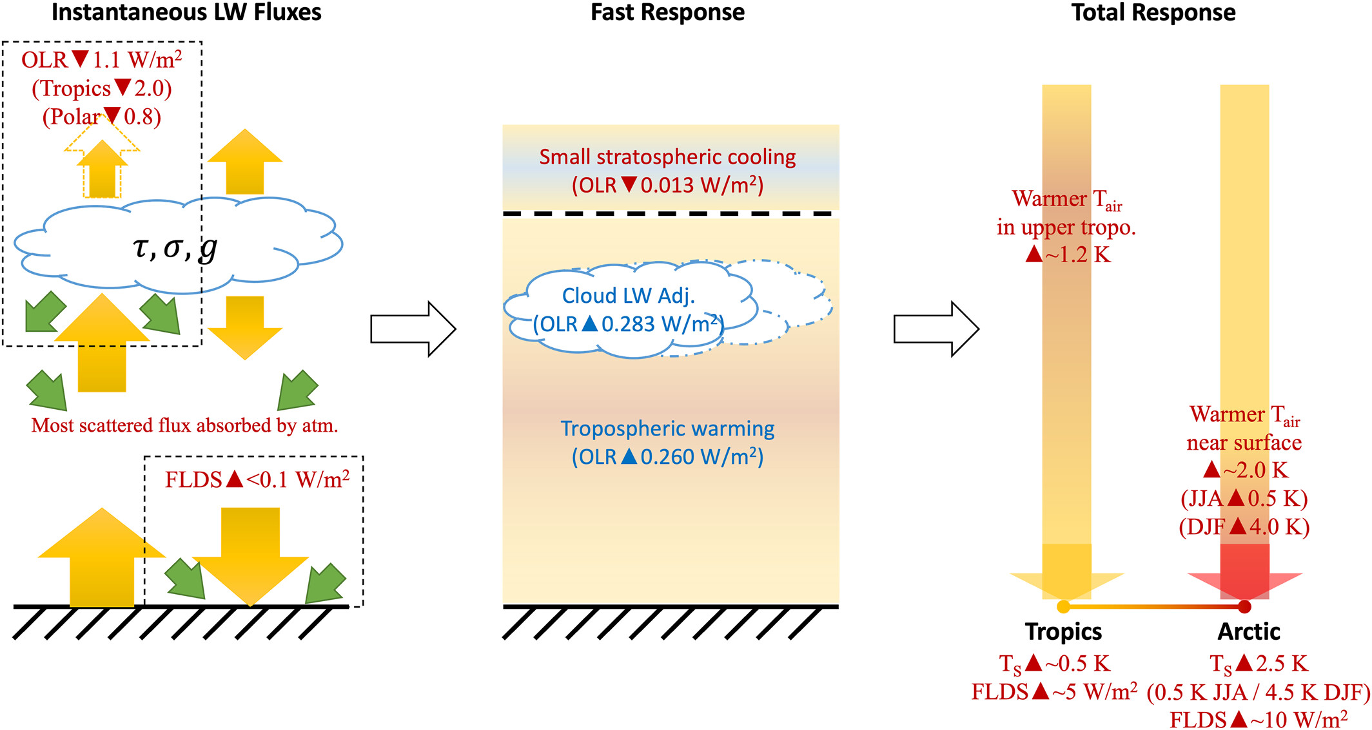
A Refined Understanding of the Ice Cloud Longwave Scattering Effects in Climate Model
Scientific Challenge
>90% of CMIP6 models do not include longwave scattering in their radiation scheme
Offline calculation shows the longwave (LW) scattering contribution to the radiation budget is not negligible.
How does including ice-cloud LW scattering affect the simulated mean-state climate and projected climate change?
Figure
Approach and Findings
Incorporated ice-cloud scattering scheme into the E3SM v2
Conducted multiple runs to evaluate its impacts
Derived new cloud radiative kernel for the E3SM v2 for feedback analyses
Significance and Impact
Ice-cloud LW scattering leads to warming with a pattern similar to the response to quadrupled CO2 in E3SM version 2
Strong Arctic warming is part of the global response to radiative perturbation rather than a local impact of LW scattering
Including ice-cloud LW scattering affects cloud feedback strength by 10%, however, it does not significantly affect the simulated responses to abrupt 4 × CO2 increases
Schematic summary of the instantaneous radiative effect (left), fast response (middle), and total responses (right) due to the inclusion of cloud LW scattering in the E3SMv2. Only prominent features are presented in the diagram. All red texts indicate a warming factor while blue texts indicate a cooling factor.
Fan, C. X., Y.-H. Chen, X. H. Chen, W. Y. Lin, P. Yang, and X. L. Huang, A Refined Understanding of the Ice Cloud Longwave Scattering Effects in Climate Model, Journal of Advances in Modeling Earth Systems, 15(10), e2023MS003810, https://doi.org/10.1029/2023MS003810, 2023.
Department of Energy • Office of Science • Biological and Environmental Research
Notes:
Word highlight text here.

