Slide 1
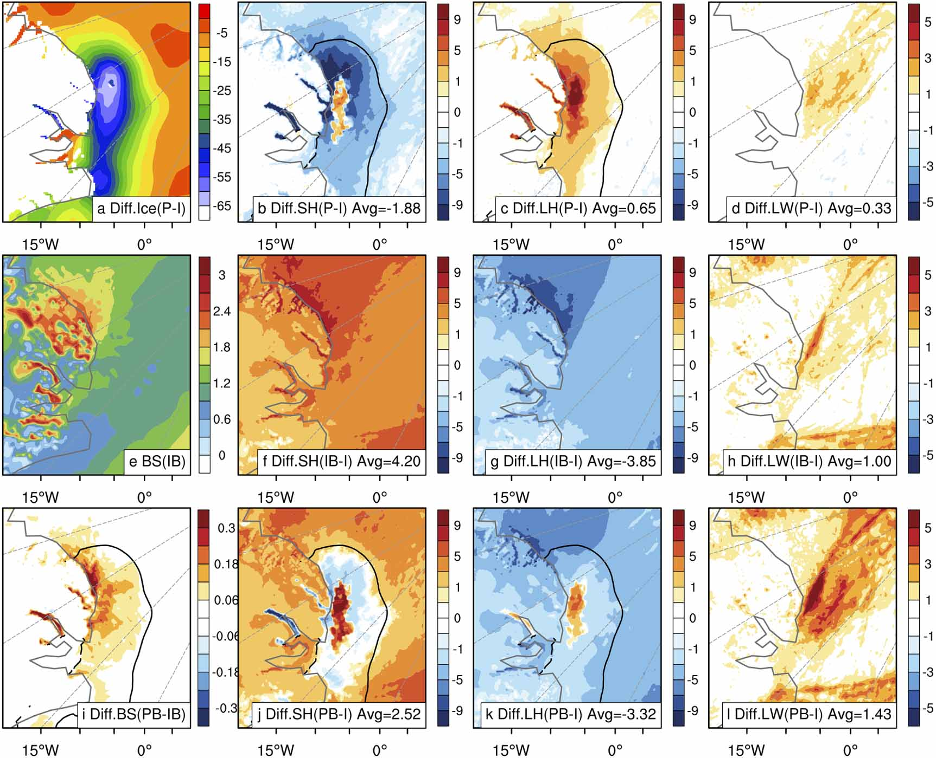
Concurrence of Blowing Snow and Polynya Enhances Arctic Surface–Atmosphere Interaction:
A Modeling Study with an Extreme Wind Event in 2018
Scientific Challenge
Strong winds induced by cyclones and anticyclones can break up sea ice, causing extremely large polynya. At the same time, blowing snow can occur complicating the sea ice-ocean-atmosphere interactions. But these processes remain unknow.
Approach and Findings
This study employs a high-resolution WRF-ice model, which is coupled with a blowing snow module and physically optimized for Arctic applications.
Blowing snow causes snow sublimation in the air, moistening the atmosphere and resulting in low-level clouds and, in turn, warming the surface to enhance the atmosphere-surface interactions.
Figure
Significance and Impact
Blowing snow processes is an emerging research topic, which has been missing in the state-of-the-art Earth System models.
The study shows its importance for a complete understanding of Arctic sea ice-ocean-atmosphere feedbacks
Top: differences of (a) sea ice concentration (SIC, %), surface (b) sensible (SH, wm⁻²) and (c) latent (LH, wm⁻²) heat fluxes, and (d) downwelling longwave radiation at the surface (LW, wm⁻²) between experiments with and without polynya. Middle: (e) vertically integrated blowing snow sublimation rate (BS 10⁻⁶ mms⁻¹) from experiment with blowing snow but without polynya, and differences of (f) SH and (g) LH, and (h) LW between experiments with and without blowing snow. Bottom: (i) difference of BS between experiments with blowing snow but with and without polynya, and differences of (j) SH, (k) LH, and (l) LW between experiments with and without both blowing snow and polynya. Black contour in b/c/i-k is for SIC of 20%. All results shown are averaged over the entire simulation period.
Citation: Jing Zhang, Xiangdong Zhang, John E Walsh, Erika L. Roesler, and Benjamin Hillman, Concurrence of blowing snow and polynya enhances arctic surface–atmosphere interaction: a modeling study with an extreme wind event in 2018. Environmental Research Climate, 2, 011004 (2023). DOI 10.1088/2752-5295/acb9b1
Department of Energy • Office of Science • Biological and Environmental Research
Notes:
Word highlight text here.

