Slide 1
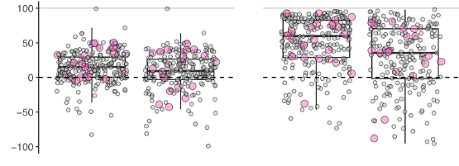
New Data-Driven Algorithm Improves Reservoir Simulations for National-Scale Hydrology
Objective
Develop a new algorithm for inferring reservoir operating policies from data and create a national-scale inventory of reservoir operating policies.
Approach
Collected records of daily operations for 600 large reservoirs in the United States.
Developed a new algorithm (“Storage Targets and Release Functions Inference Tool”—STARFIT) for inferring reservoir operating policies from data and extrapolating the policies to data-scarce reservoirs (“STARFITx”), building on prior research focused on the Columbia River Basin.
Simulated rules and compared performance to existing method used in large-scale hydrology.
Impact
STARFIT provides a substantial and robust improvement over existing practice.
STARFIT enables the creation of the first inventory of reservoir operations covering all large reservoirs in the United States.
STARFIT unlocks continental-scale hydrology for a range of multisectoral dynamics research applications relying on accurate water storage and release (e.g., drought and flood impacts, hydropower generation).
Error reduction relative to conventional method
%
Simulated water release
Simulated water storage
STARFIT
STARFITx
STARFIT
STARFITx
Reservoir storage capacity
Error (nRMSE) reduction for STARFIT (policy inferred from data) and STARFITx (policy extrapolated from nearby, similarly purposed reservoirs) relative to the popular Hanasaki generic reservoir method. Each point represents a simulated reservoir. Boxplots give the interquartile range with whiskers extending to 1.5 times the interquartile range. The STARFIT-based simulations offer substantial, robust improvements in storage simulation (~50% reduction in error on average) and release simulation (~20% reduction in error on average) relative to conventional practice.
Turner, S.W.D., Steyaert, J.C., Condon, L., Voisin, N. “Water storage and release policies for all large reservoirs of conterminous United States” Journal of Hydrology, 603(A), 126843, (2021). [DOI: 10.1016/j.jhydrol.2021.126843]

