Slide 1
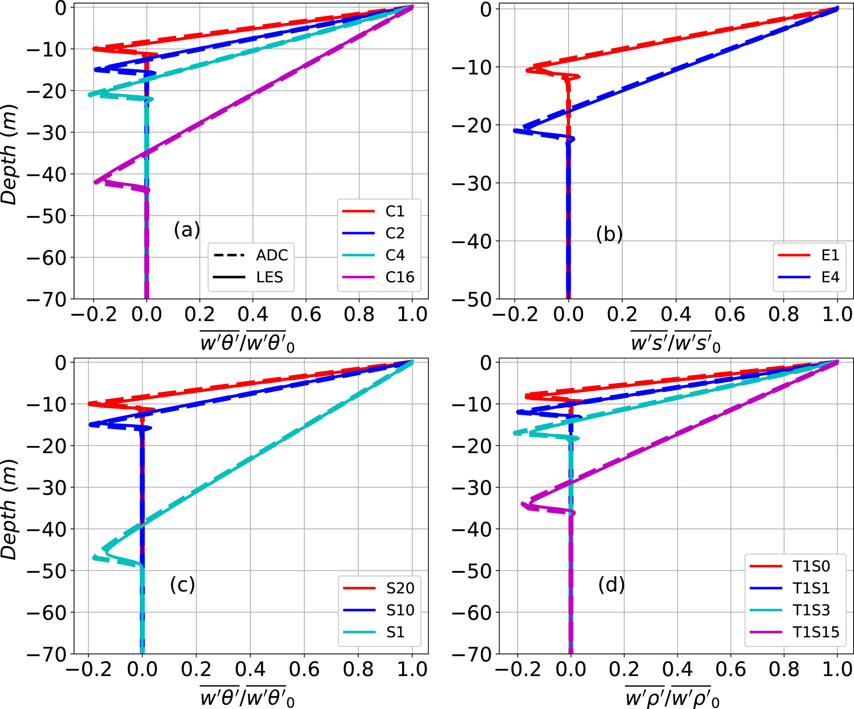
A New Hybrid Mass-Flux/High-Order Turbulence Closure for Ocean Vertical Mixing
Scientific Challenge
Upper ocean mixing processes have substantial influence on climate and weather systems
Accurate representation of these effects on the global climate and in ocean models is crucial for understanding our current and changing climate
However, current mixing schemes used in these models have shown significant biases
Approach and Findings
We present a new physically-motivated mixing scheme for the upper ocean inspired by atmospheric mixing schemes
We show that the proposed mixing scheme can simulate upper ocean mixing efficiently
Significance and Impact
Results suggest its potential use in climate and ocean models to help reduce model biases
Normalized vertical turbulent flux profiles of (a) heat for surface heat flux cases (C1, C2, C4, and C16), (b) salinity for surface salinity flux cases (E1 and E4), (c) heat for initial stratification cases (S1, S10, and S20), and (d) buoyancy for combined surface heat flux and salinity flux cases (T1S0, T1S1, T1S3, and T1S15) for both large eddy simulation (solid lines) and the Assumed-Distribution Higher-Order Closure model (dashed lines) on the final day of the simulations.
Garanaik, A., Pereira, F. S., Smith,K., Robey, R., Li, Q., Pearson, B., &Van Roekel, L. (2024). A new hybrid mass-flux/high-order turbulence closure for ocean vertical mixing. Journal of Advances in Modeling Earth Systems,16, e2023MS003846.
Department of Energy • Office of Science • Biological and Environmental Research
Notes:
Word highlight text here.

