Slide 1
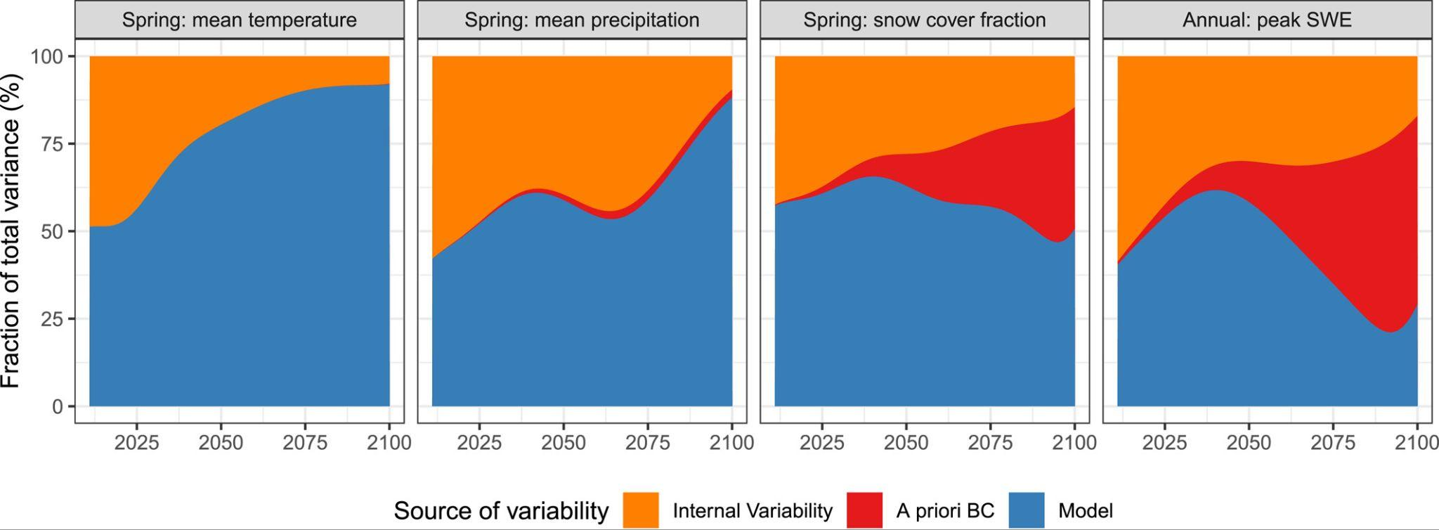
Bias correction of GCM boundary conditions in dynamical downscaling is defensible!
Objective
Assess the potential for climate change distortion when bias correction (BC) of the GCM boundary conditions is applied in dynamic downscaling
Approach
For Global Climate Models (GCMs) in the Western United States Dynamically Downscaled Dataset (WUS-D3), conduct twin simulations with bias correction of the GCM boundary conditions applied
Perform a variance decomposition to assess BC’s distortion of climate trends, alongside other sources of uncertainty
Impact
BC is defensible in dynamic downscaling, as its introduced uncertainty is small relative to structural and natural variability uncertainties for precipitation and temperature. For snow meanwhile, trend distortion is large, but snow in non-bias corrected experiments is so large that it may not be fair to call this a trend distortion.
Fraction of total variability (%) over time in western-U.S.-wide averages of selected variables due to model choice (blue), the effect of a priori bias correction (red), and internal variability (orange). Note that a minimum SWE mask is applied before taking Western U.S. averages for spring snow cover fraction and annual peak SWE; see Figure 3.
Risser, M. D., Rahimi, S., Goldenson, N., Hall, A., Lebo, Z. J., and Feldman, D. R.: Is Bias Correction in Dynamical Downscaling Defensible?, Geophysical Research Letters, 51, e2023GL105979, https://doi.org/10.1029/2023GL105979

