Slide 1
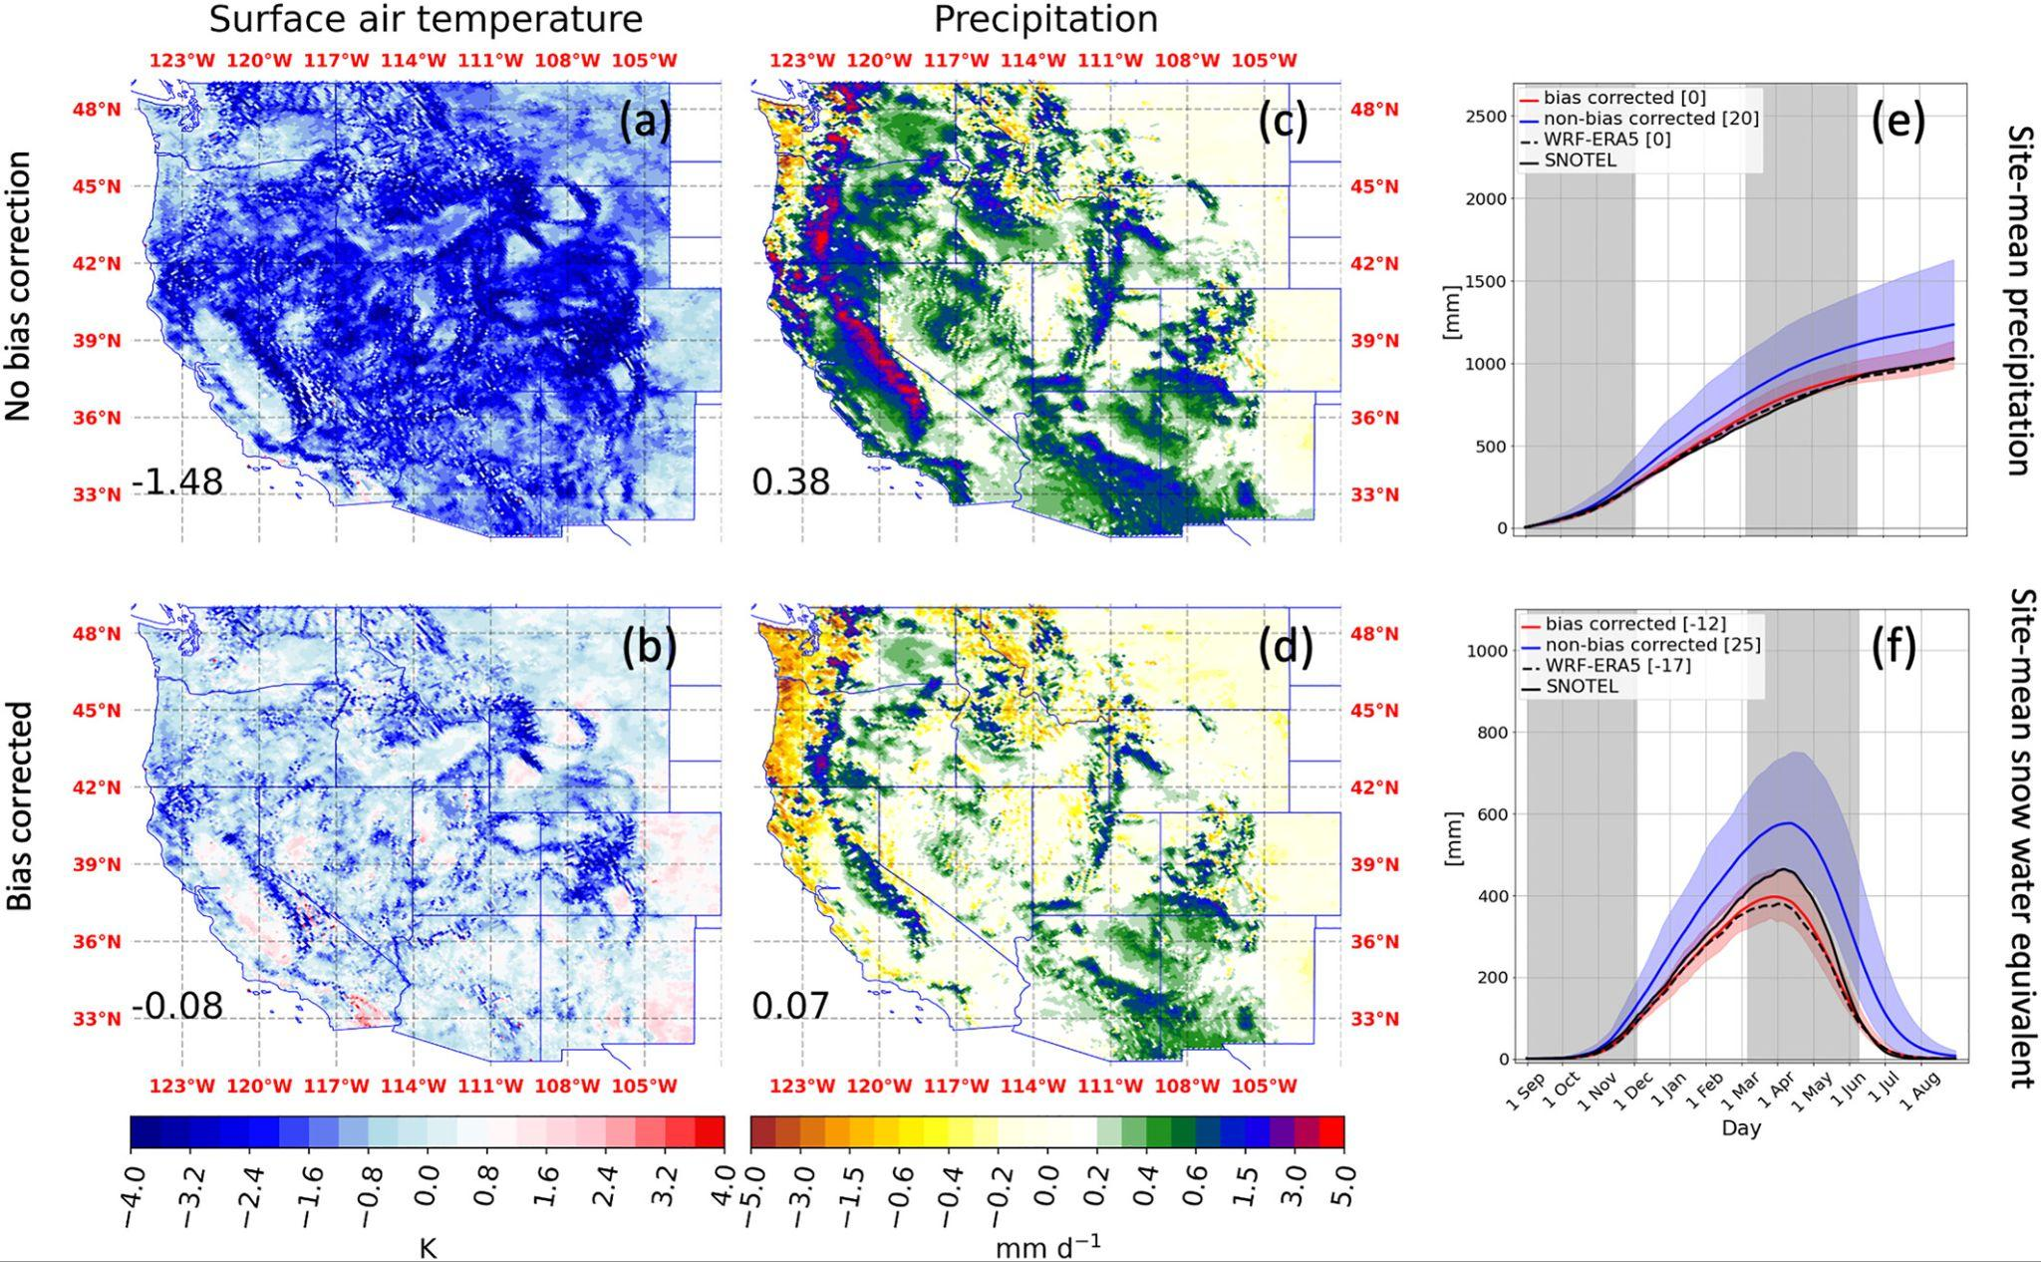
High Resolutions can make climate information worse!
Objective
Despite a rigorous GCM selection process and regional climate model (RCM) testing, the Western United States Dynamically Downscaled Dataset (WUS-D3) had large hydroclimatic biases. We implemented a simple bias correction procedure (delta method) to ameliorate this issue.
Approach
We bias correct the GCM boundary conditions for 9 Coupled Model Intercomparison Project Phase 6 (CMIP6) GCMs and compare their bias profiles to twin WUS-D3 (non-bias corrected experiments).
Impact
Bias correction of the GCM boundary conditions leads to physically interpretable improvements in RCM capabilities in simulating western U.S. mean hydroclimate, as well as extreme precipitation. Mean biases in CMIP6 GCMs are surprisingly similar, and this study is a line of evidence supporting the need to bias correct before dynamic downscaling.
PRISM, ensemble-mean climatological (1981–2010) bias patterns in annual-mean (a and b) temperature and (c and d) precipitation, with 11-state-mean biases indicated in the lower-left of each subpanel. (e and f) Time series of cumulative annual precipitation and snow water equivalent, respectively [mm], across 703 SNOTEL sites.
Rahimi, S., Huang, L., Norris, J., Hall, A., Goldenson, N., Risser, M., Feldman, D. R., Lebo, Z. J., Dennis, E., and Thackeray, C.: Understanding the Cascade: Removing GCM Biases Improves Dynamically Downscaled Climate Projections, Geophysical Research Letters, 51, e2023GL106264, https://doi.org/10.1029/2023GL106264

