Slide 1
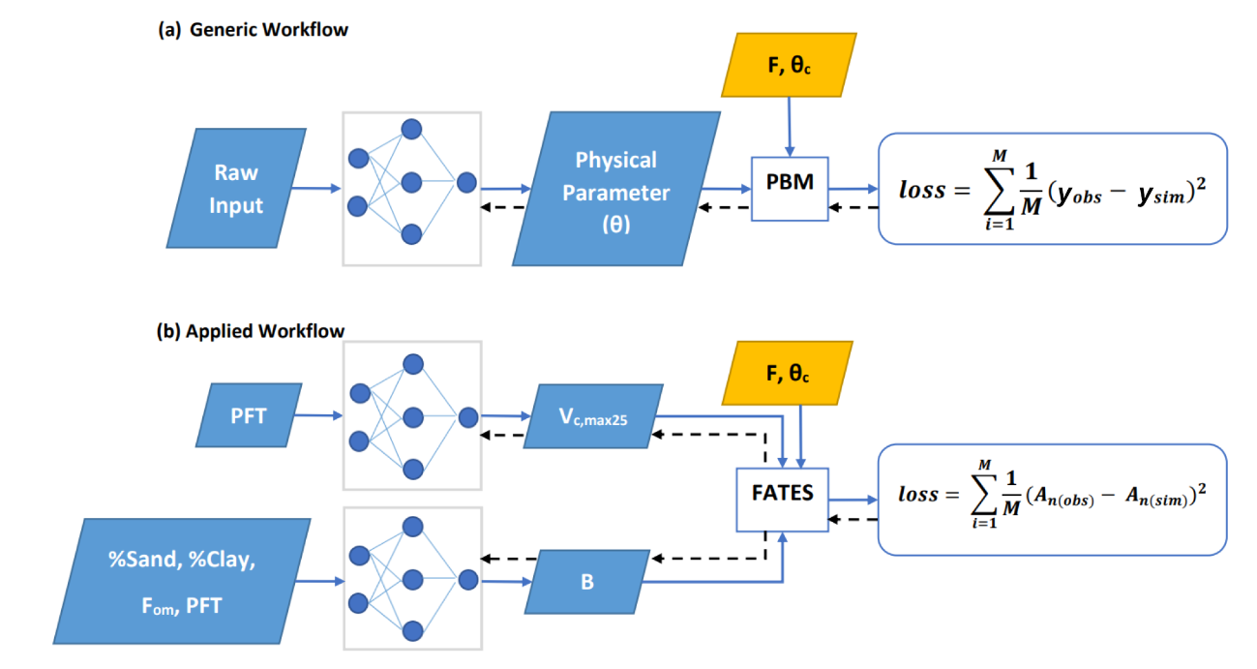
A differentiable, physics-informed ecosystem modeling and learning framework for large-scale inverse problems: Demonstration with photosynthesis simulations
Objective
Reimplement the photosynthesis module from FATES so that it becomes programmatically differentiable and connect it to NNs for parameter estimation.
Approach
Differentiable models couple physics-based formulations to neural networks (NNs) that learn parameterizations (and potentially processes) from observations, here photosynthesis rates.
Impact
The parameters learned here performed substantially better and greatly reduced biases compared to literature values. These methods can be applied to other ecosystem models to improve predictions and increase our knowledge.
The differentiable framework allowed us to gain insights at a large scale. For example, our results showed that the carboxylation rate at 25°C (V_{c,max25}) was more impactful on photosynthesis rates than a factor representing water limitation, although tuning both was helpful in addressing biases with the default values.
Figure 1. Diagram showing the differentiable parameter learning (dPL) framework, which is a hybrid of NNs and the photosynthesis module in the FATES ecosystem model written on a differentiable platform. (a) The generic workflow: some raw information is mapped into physical parameters via an NN. These parameters are sent into a PBM, which then outputs the simulations, y_{sim}, that are compared with the observations, y_{obs}. Direct supervision for the physical parameters themselves is not required – we do not need ground truth values for these parameters. The loss function is “global” in that it involves all training data points, rather than being computed site-by-site as done in traditional calibration. (b) The workflow for the computational example described in this work. We estimate either Vc,max25 or the parameter B, or both of them at the same time, using NNs. The parameters are then fed into the differentiable photosynthesis module in FATES, which then outputs the net photosynthesis rate, A_{n(sim)}, that is compared with A_{n(obs)}. When not estimated from the data, default values from the literature were used. Blue arrows show the running of the NNs with the PBM in a forward (“prediction”) mode, while black arrows indicate backpropagation from the loss function back through the differentiable model equations to the NNs to update their weights, which is only done during initial NN training.
Aboelyazeed, D., Xu, C., Hoffman, F. M., Liu, J., Jones, A. W., Rackauckas, C., Lawson, K., & Shen, C. (2023). A differentiable, physics-informed ecosystem modeling and learning framework for large-scale inverse problems: Demonstration with photosynthesis simulations. Biogeosciences, 20(13), 2671–2692. https://doi.org/10.5194/bg-20-2671-2023

