Slide 1
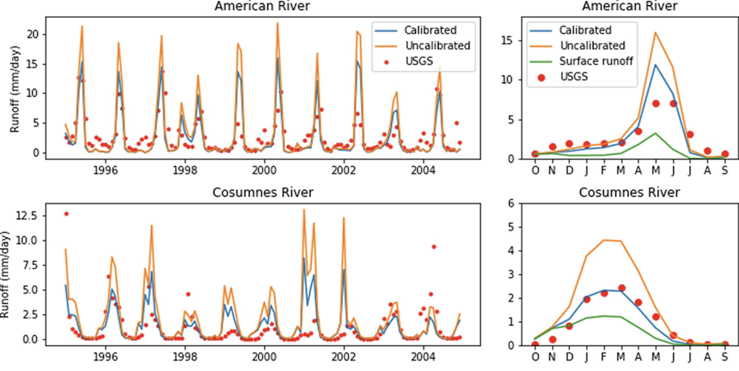
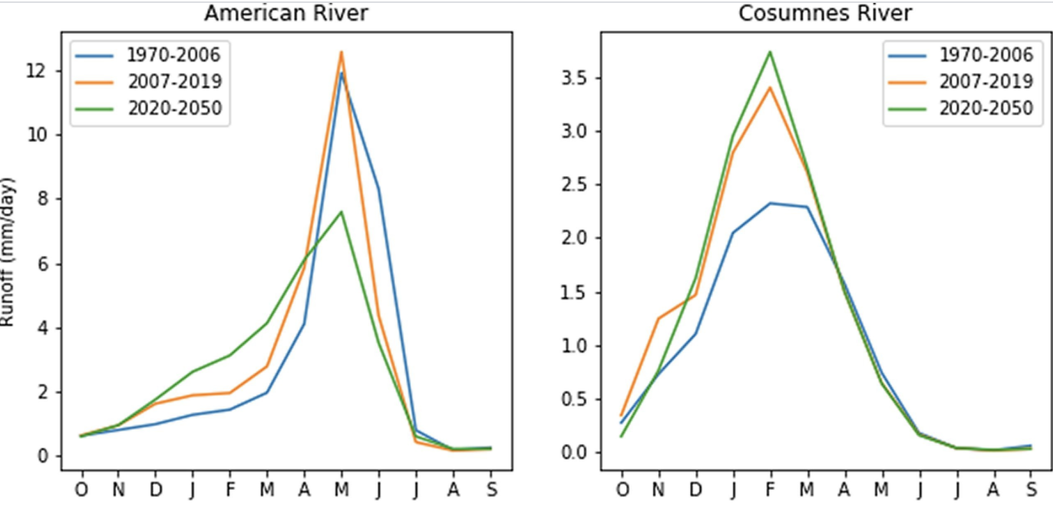
Hydrological Analysis in Watersheds with a Variable-Resolution Global Climate Model (VR-CESM)
Scientific Challenges
Hydrological analysis at watershed scale are important to guide water resources management. While distributed hydrological models are applied at watershed scale, global climate models are rarely used due to coarse grid resolution. In this study, a global climate model at refined-resolution makes hydrological analysis possible at watershed scale.
Approach and Results
The dynamic-downscaled refined-resolution global climate model outputs were calibrated and validated to show good matches with streamflow observations. Under RCP8.5 VR-CESM indicates high geographic variation in future changes to streamflow, with dependencies on snow- vs rain-dominated areas and how close a snow-dominated area is to a threshold between the two.
Upper: 10-year & monthly average calibration of runoff simulation vs. streamflow
Lower: Simulated runoff during historical, validation and projection periods in American River (snow-dominated) and Cosumnes River (rain-dominated) watersheds
Significance
We demonstrate that refined-resolution global climate model outputs can be used for hydrological analysis with careful calibration at four unmanaged, headwater watersheds in the western U.S.
Impacts of climate change vary in watersheds: In higher-temperature snow-dominated watersheds, decreasing snowpack and early snowmelt shifts runoff peaks earlier and reduces streamflow magnitude. In rain-dominated watersheds, precipitation and peak runoff increase in the wet season.
Increased variation of annual average runoff indicates the potential for more extremely dry and wet years in the projection periods.
Xu Z., Di Vittorio A. (2021), Hydrological analysis with a variable-resolution global climate model (VR-CESM). Journal of Hydrology, DOI: 10.1016/j.hydrol.2021.126646

