Slide 1
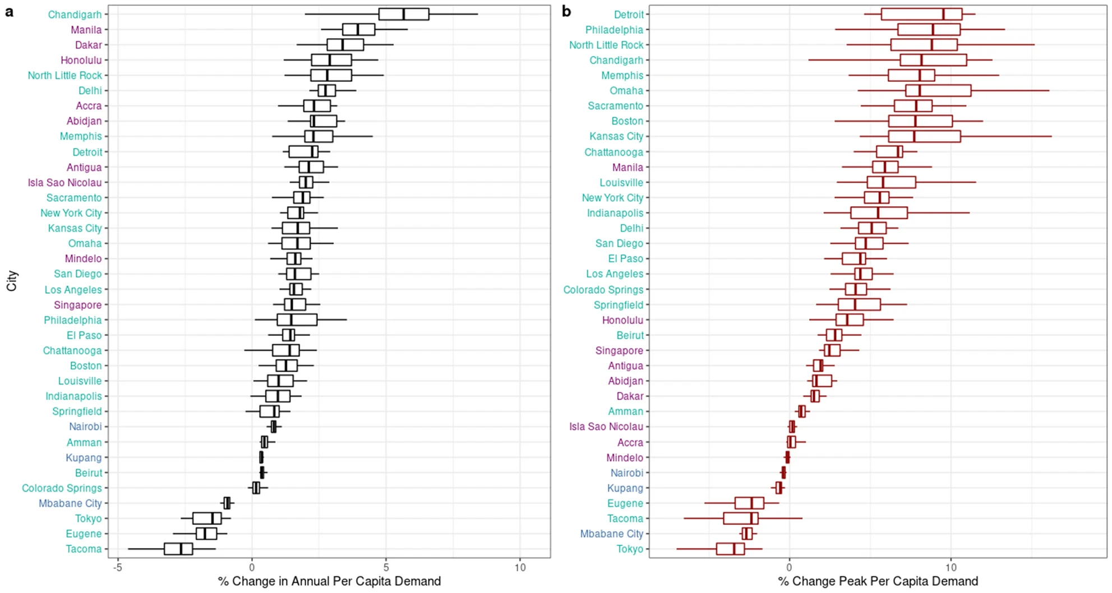
Heterogeneous climate change impacts
on electricity demand in world cities circa mid-century
Objective
Prior research indicates a latitudinal gradient in the effect of climate change on energy consumption as an adaptation to rising temperatures
Adaptation will be concentrated in urban areas, home to 68% of the world’s population by 2050
We characterize the impact of climate change on electricity demand, and its fine spatial and temporal scale drivers, across 36 world cities
Approach
Using a unique dataset of hourly electric load over multiple years, we estimate the response of electricity demand to temperature
The resulting reduced-form empirical responses are coupled with temporally downscaled global climate model (GCM) simulated temperatures
Figure: Percent changes in (a) annual and (b) 95th percentile electricity demand to the shift in hourly temperatures circa 2050, 21 GCM simulations of RCP 8.5 warming. Text colors correspond to the shape of cities’ electricity demand responses to temperature: “V”-shaped, increasing, unresponsive.
Impact
Cities’ demand responses, future climatic exposures and electricity consumption impacts are heterogeneous, with changes in annual consumption of −2.7% to +5.7%, and peak power demand increases of up to 9.5% at the multi-GCM median
The largest impacts are concentrated in economically developed mid-latitude cities, with tropical developing areas exhibiting smaller changes
Results highlight the importance the structure of electricity demand: tropical cities experience large temperature increases but impacts are offset by inelastic demand responses, likely attributable to air conditioning lower prevalence
Romitti, Y. and I. Sue Wing (2022). Heterogeneous climate change impacts on electricity demand in world cities circa mid-century. Scientific Reports 12: 4280 https://doi.org/10.1038/s41598-022-07922-w

