Slide 1
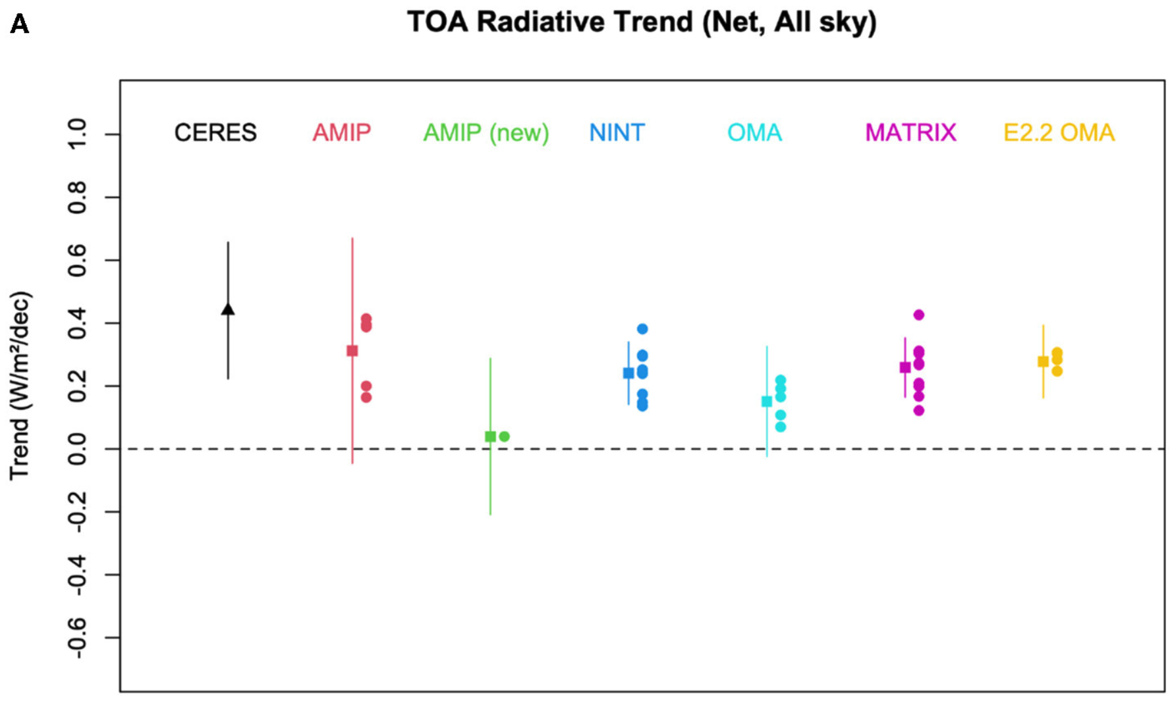
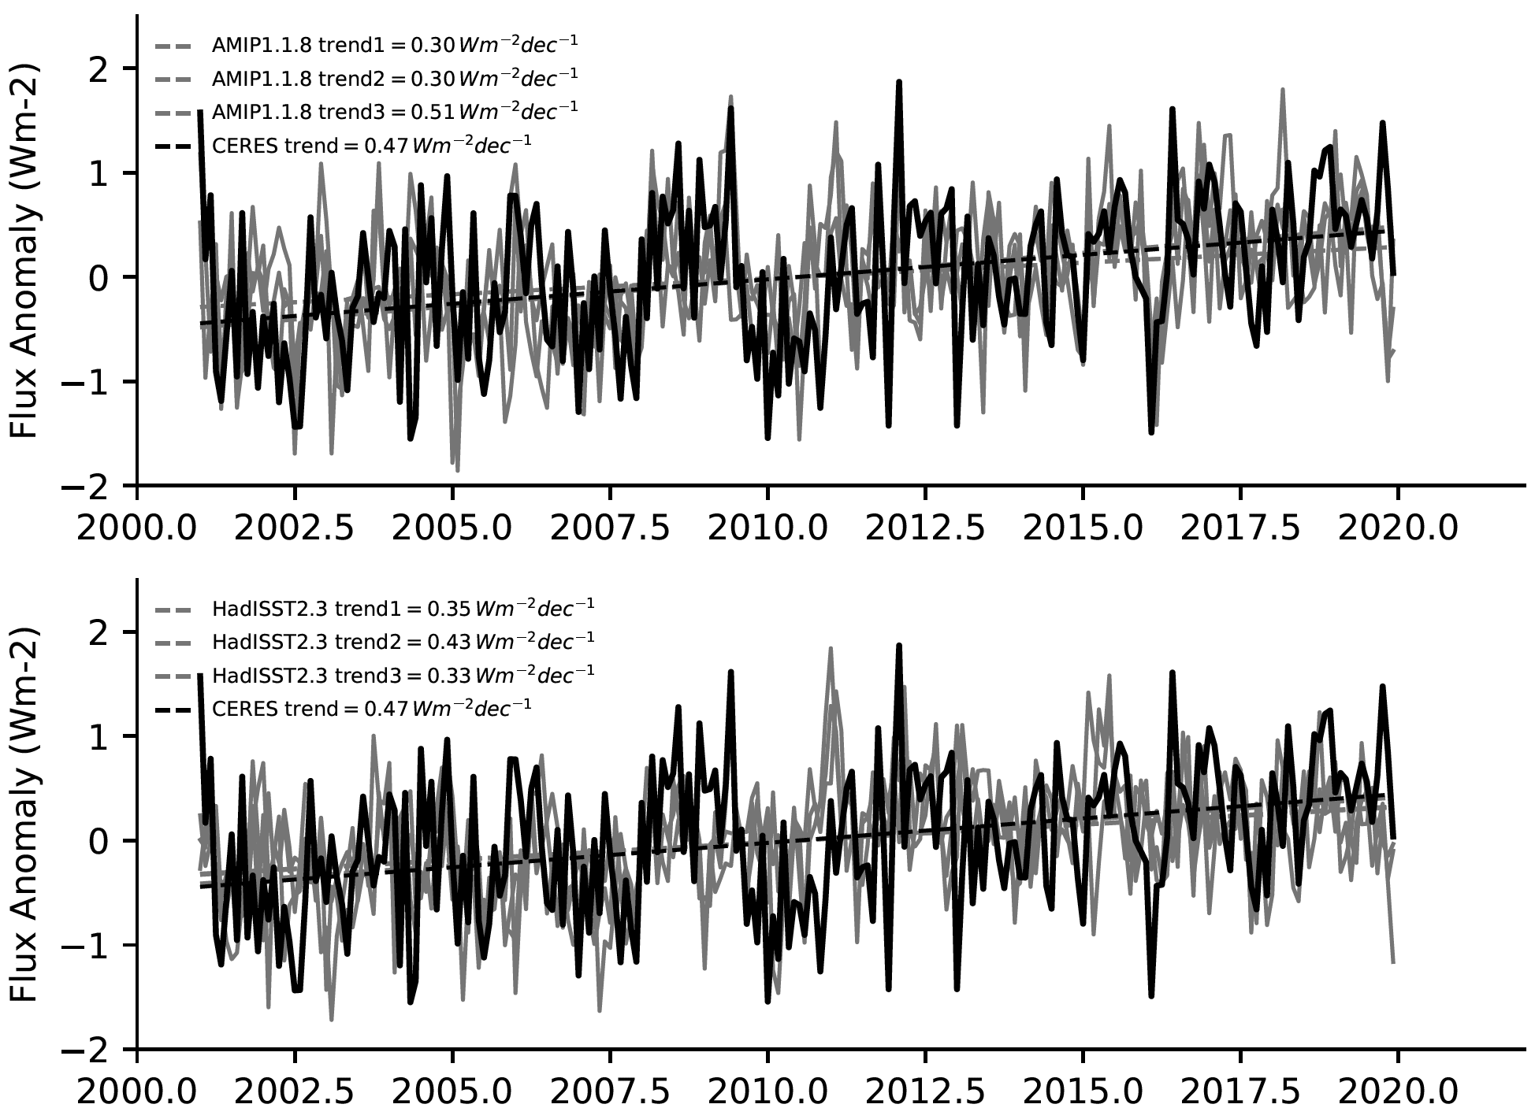
CERESMIP – investigating recent trends in Earth’s Energy Imbalance
Science Question
More than two decades of observed NASA CERES Earth’s Energy Imbalance (EEI) data are available, however, current generation CMIP6 historically-forced simulations conclude in 2014, omitting almost a full decade of the observed period.
Key Accomplishments
Define a new protocol to target this period of good EEI observational coverage, which includes the standard CMIP AMIP experiment augmented with targeted single-forcing experiments to decompose drivers and responses.
Investigate available alternate forcing datasets to complement the official CMIP DECK forcing suite produced for CMIP6, including a number of independent NASA derived products that cover the 2001-2021 target period.
Impact
Engaged with eight CMIP-contributing modeling groups and a broader scientific community to augment and fine-tune experiment definitions and protocols
Will undertake light-weight atmospheric only simulations in late 2023/early 2024 as new CMIP Forcing Task Team datasets come online, publishing data to CMIP6Plus
Top of Atmosphere (ToA) radiative trends (net, all sky)
A
A. Top of Atmosphere (ToA) net (both short and long-wave) radiative trends for the NASA-GISS GISS-E2.1-G and GISS-E2.2-G models with varying physics schemes.
B. Top of Atmosphere (ToA) net (both short and long-wave) radiative trends for the HadGEM3-GC3.1-LL model, using two separate SST and sea ice datasets (top and bottom panels respectively)
B
Schmidt, G. A., Andrews, T., Bauer, S. E., Durack, P. J., et al. (2023). CERESMIP: a climate modeling protocol to investigate recent trends in the Earth’s Energy Imbalance. Front. Clim., 5, 10 pp. 10.3389/fclim.2023.1202161

