Slide 1
Ocean Property Transformation as a Climate Evaluator
Science Question
How realistic are CMIP-class models at representing Southern Ocean (SO) changes forced by wind and Antarctic meltwater?
What role does model resolution play in the near-coastal simulation realism?
Key Accomplishments
Sensitivity of two (high/medium) resolution ocean models tested for idealized fresh/meltwater and windstress perturbations
Connections between watermass transformation (WMT), meridional overturning (MOC) and ocean ventilation evaluated for the SO
Higher resolution model shows 4x reduction in Antarctic Abyssal Water (AABW) production and export, a startling difference due immense role of deep SO in global heat and carbon storage
Impact
Highlighted high future climate sensitivity linked to Southern Ocean realism
xWMT module contributed to RGMA CMEC toolkit to facilitate WMT analysis on CMIP archive
Simulated ocean processes across experiments
Schematic of processes associated with Antarctic Bottom Water (AABW) production and export, in the control configuration (a), and the Antwater experiment for the high-resolution (b, CM4 0.25deg) and lower-resolution (c, ESM4 0.5deg) NOAA-GFDL ocean model configurations
Tesdal, J.-E., MacGilchrist, G. A., Beadling, R. L., Griffies, S. M., Krasting, J. P. and Durack, P. J. (2023). Revisiting Interior Water Mass Responses to Surface Forcing Changes and the Subsequent Effects on Overturning in the Southern Ocean. J. Geophy. Res., 128 (3), e2022JC019105. https://doi.org/10.1029/2022JC019105

Slide 2
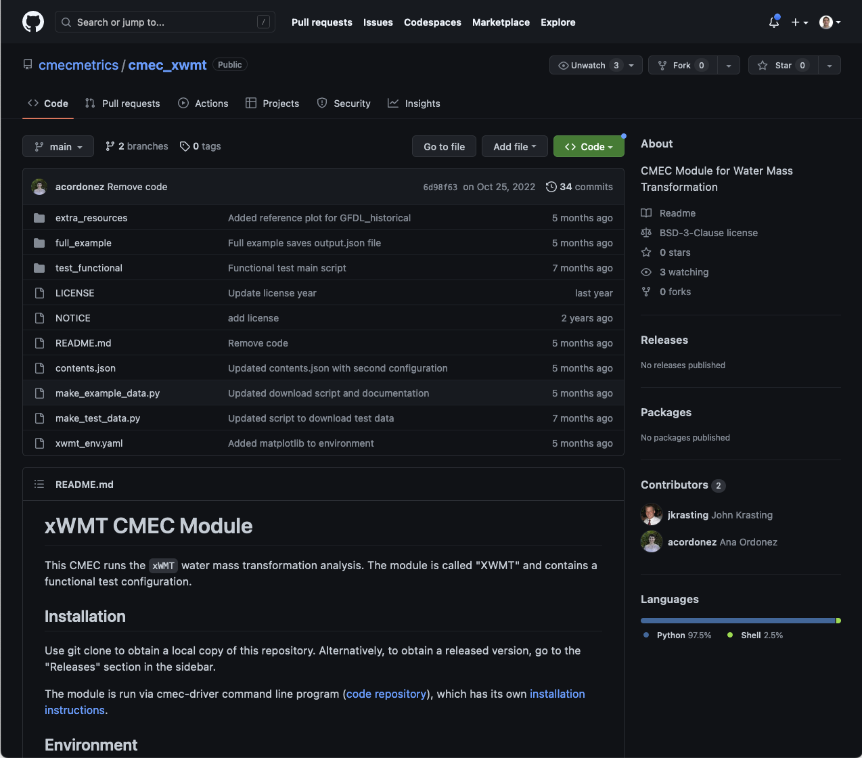
Ocean Property Transformation as a Climate Evaluator
Science Question
How realistic are CMIP-class models at representing Southern Ocean (SO) changes forced by wind and Antarctic meltwater?
What role does model resolution play in the near-coastal simulation realism?
Key Accomplishments
Sensitivity of two (high/medium) resolution ocean models tested for idealized fresh/meltwater and windstress perturbations
Connections between watermass transformation (WMT), meridional overturning (MOC) and ocean ventilation evaluated for the SO
Higher resolution model shows 4x reduction in Antarctic Abyssal Water (AABW) production and export, a startling difference due immense role of deep SO in global heat and carbon storage
Impact
Highlighted high future climate sensitivity linked to Southern Ocean realism
xWMT module contributed to RGMA CMEC toolkit to facilitate WMT analysis on CMIP archive
Tesdal, J.-E., MacGilchrist, G. A., Beadling, R. L., Griffies, S. M., Krasting, J. P. and Durack, P. J. (2023). Revisiting Interior Water Mass Responses to Surface Forcing Changes and the Subsequent Effects on Overturning in the Southern Ocean. J. Geophy. Res., 128 (3), e2022JC019105. https://doi.org/10.1029/2022JC019105
https://github.com/cmecmetrics/cmec_xwmt

