Slide 1
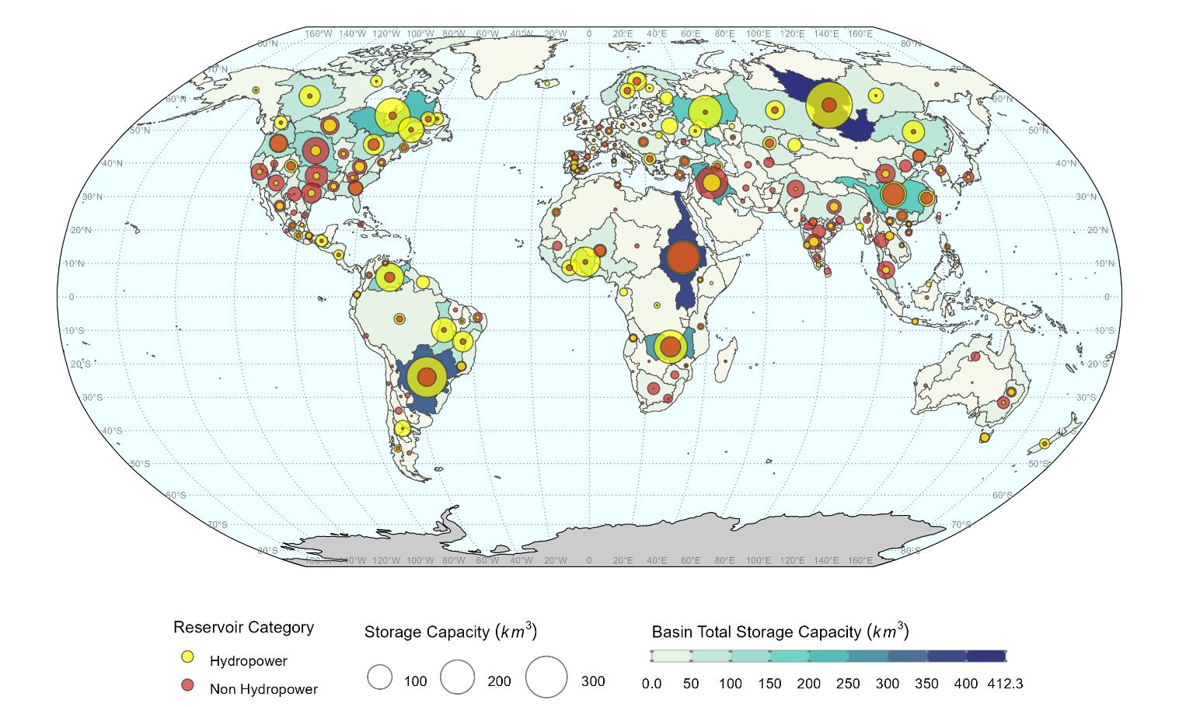
Representing Reservoir Water Storage in a Human-Earth Systems Model: A Key to Managing Future Water Challenges
Objective
Explore the future role of global reservoir water storage in meeting multi-sector human demands and its interactions with climate, land, and energy systems.
Approach
Develop the GLObal Reservoir Yield (GLORY) model to dynamically link with the Global Change Analysis Model (GCAM), enhancing the representation of reservoir water storage capacity.
Construct a renewable water supply curve by deriving the capacity–yield relationship with information on hydrology, reservoir costs, and expansion constraints, enabling simulation of future reservoir storage expansion pathways.
Implement a feedback loop between GCAM and GLORY, where GCAM's sectoral water demand inform GLORY's optimization process, generating updated supply curves that reflect changing socioeconomic and hydrologic conditions.
Impact
GLORY and GCAM coupling reveals that sub-annual discrepancies between water supply and demand significantly influence reservoir water yield and cost.
Feedback mechanisms between GCAM and GLORY show that evolving water demands can lead to higher water prices and reduced surface water withdrawals in water-scarce basins.
The study highlights that reservoir storage capacity expansion is crucial for mitigating water scarcity, with regional variations in cost and effectiveness driven by hydrologic and economic factors.
Historical reservoir storage capacity (km3) for hydropower and non-hydropower reservoirs across 235 basins globally. The yellow and red circles indicate hydropower and non-hydropower reservoir storage, respectively. The size of the circle indicates the total storage capacity for each of the two reservoir categories within the basin. The background color by which each basin is shaded quantifies the sum of the storage capacity for both reservoir categories. This figure highlights the distribution of reservoirs with different purposes across global basins, and how their purpose can help address water challenges in water-scarce basins.
Zhao, Mengqi, Thomas B. Wild, Neal T. Graham, Son H. Kim, Matthew Binsted, A. F. M. Kamal Chowdhury, Siwa Msangi, Pralit L. Patel, Chris R. Vernon, Hassan Niazi, Hong-Yi Li, and Guta W. Abeshu. 2024. GCAM–GLORY v1.0: Representing Global Reservoir Water Storage in a Multi-Sector Human–Earth System Model. Geoscientific Model Development 17: 5587–5617. https://doi.org/10.5194/gmd-17-5587-2024.

