Slide 1
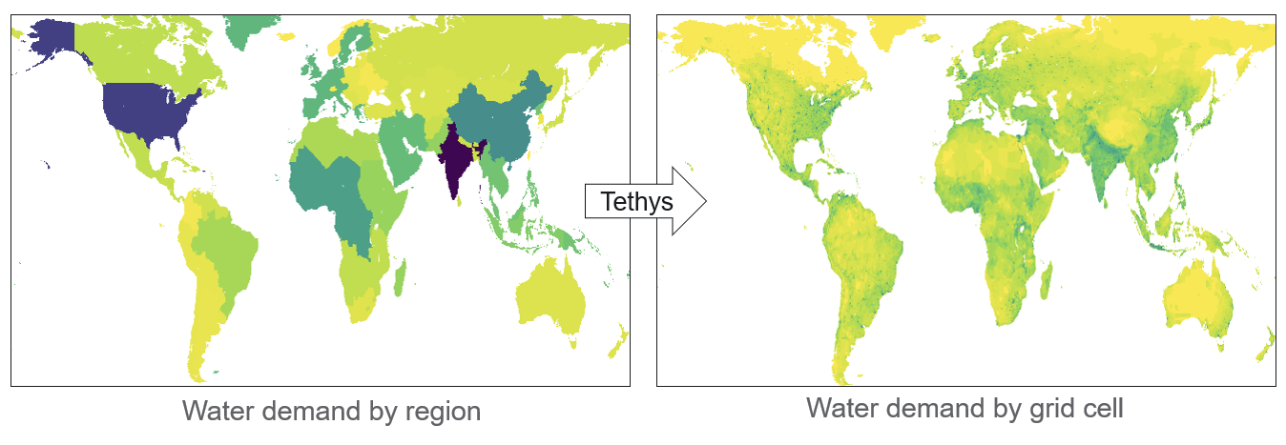
Refining Future Water Demand Projections with Sector-specific Downscaling
Objective
Enable the integration of fine-scale hydrologic models with models that account for multi-sectoral dynamics, e.g., the Global Change Analysis Model (GCAM), by downscaling coarse region-scale, sectoral water demand projections to high-resolution gridded data.
Approach
Develop the Tethys model to disaggregate regional sectoral water demands to grid cells using spatial proxies (e.g., population), ensuring proportional allocation based on the relationship between demand and proxy values.
Apply sector-specific temporal allocation algorithms from existing literature to allocate annual water demands across months, utilizing relationships between monthly water demand and other variables.
Generalize the downscaling process through a flexible interface that allows configuration of proxy rules and specification of target output resolution, facilitating integration with various model-integration workflows.
The Tethys model downscales coarse regional water demand data from the Global Change Analysis Model (GCAM) for six sectors (domestic/municipal, electricity generation, manufacturing, mining, livestock, and irrigation) into high-resolution, gridded data that can be utilized to refine Earth systems models.
Impact
Tethys enables the integration of fine-scale hydrologic models with multi-sector dynamic models by downscaling region-scale water demand projections using sector-specific proxies and algorithms.
Tethys has now been generalized to be able to downscale sectoral water demand from ensembles of socioeconomic, climate, and other scenarios to provide a flexible and robust utility for scalable scientific research.
Thompson, Isaac, Chris R. Vernon, and Zarrar Khan. 2024. Tethys: A Spatiotemporal Downscaling Model for Global Water Demand. Journal of Open Source Software 9 (97): 5855. https://doi.org/10.21105/joss.05855.

