Slide 1
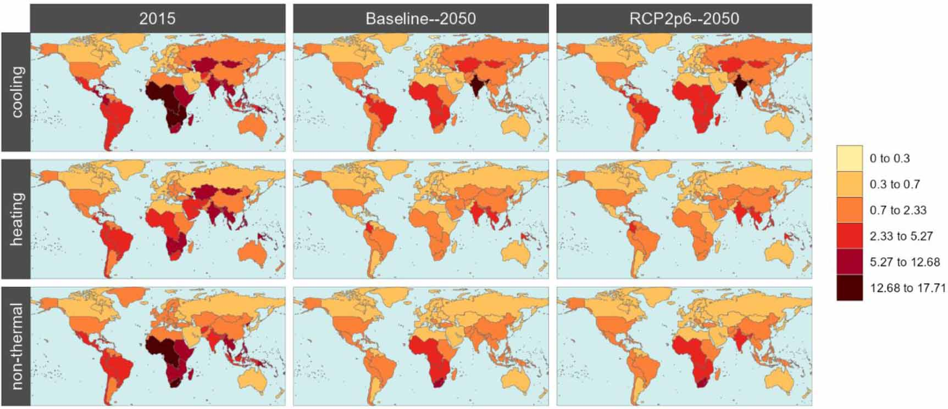
Future Distribution of Energy Demand Across Income Levels
Objective
Explore the effects of income growth and distribution on residential energy consumption across multiple scenarios, focusing on regional household energy services and fuel choices by income decile.
Approach
Analyze household energy services and fuel choices by income decile using the Global Change Analysis Model (GCAM), a global, integrated, multisector dynamics model.
Use SSP-specific projections of population, GDP per capita, and income distribution pathways in GCAM to project future residential energy demand and emissions by income decile.
Impact
Future residential energy service demand increases globally, driven by population and income growth, with lower-income regions showing larger increases, as they are further from satiation levels.
Although they contribute a small fraction of total greenhouse gas emissions, in all scenarios, lower income groups continue to rely on more polluting traditional fuels, which are related to higher exposure to household air pollution.
Energy expenditures as a share of income are disproportionately high for lower- income groups, with significant regional variations, as the absolute level of income varies across regional deciles.
Figure shows the Palma ratio – relative levels of modern energy service consumption across income groups – for residential cooling, heating, and other energy services within regions in 2015 (first column) and two projections for 2050 – a scenario without major shifts in the energy system (second column) and a scenario that transitions to a low-carbon energy system. Darker colors indicate less energy consumption for the lowest deciles relative to the highest decile.
Palma ratio = D1/(SUM(D1:D4)). Note that intraregional differences are not shown.
Sampedro, Jon, Stephanie T. Waldhoff, James A. Edmonds, Gokul Iyer, Siwa Msangi, Kanishka B. Narayan, Pralit Patel, and Marshall Wise. 2024. Residential Energy Demand, Emissions, and Expenditures at Regional and Income-Decile Level for Alternative Futures. Environmental Research Letters 19 (8): 084031. https://doi.org/10.1088/1748-9326/ad6015.

