Slide 1
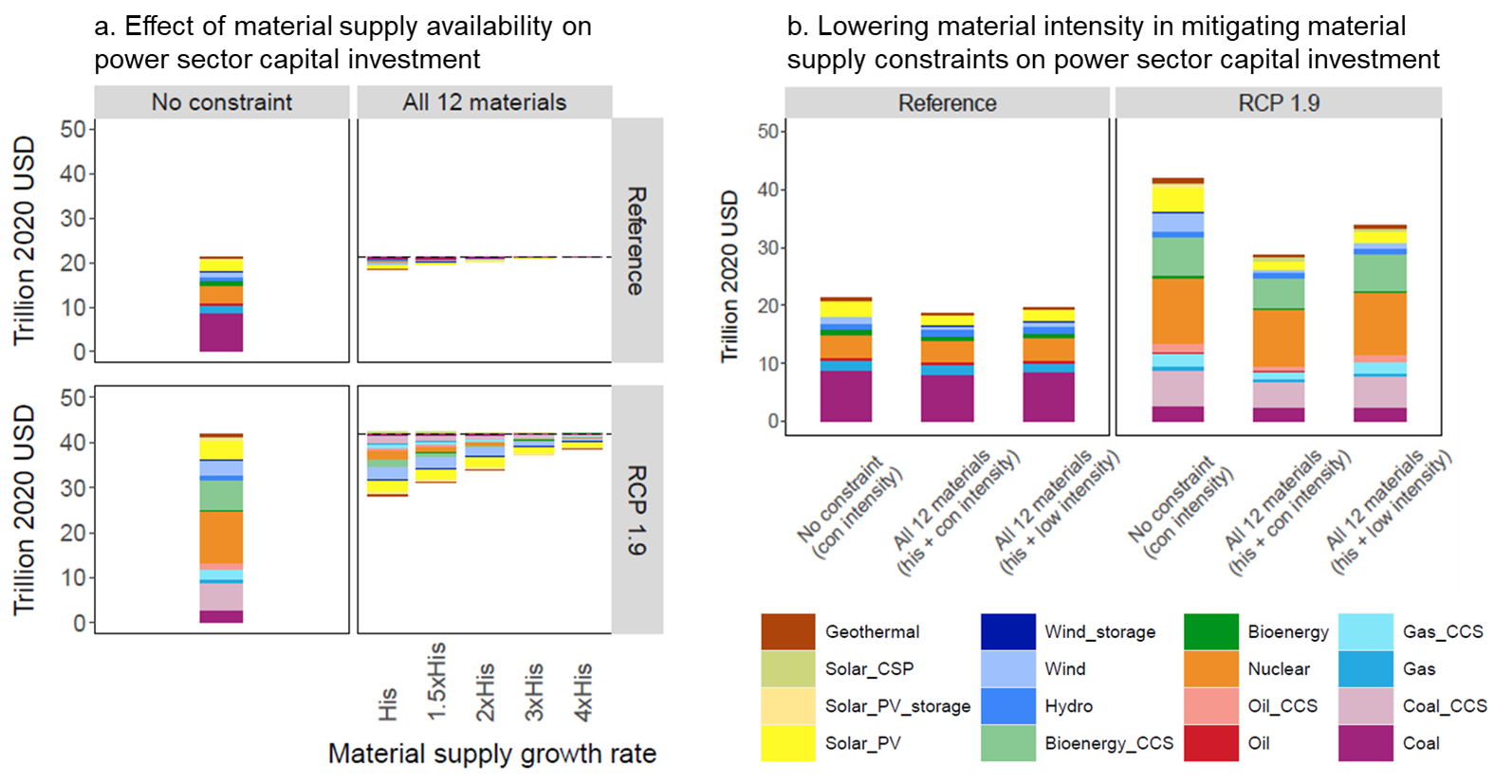
Material Supply Availability Pose Potential Challenges to Future Power Sector Expansion
Objective
Evaluate the impacts of material supply availability on the evolution of the global power sector, highlighting the potential restrictions on capacity expansion and increased electricity price if material supplies continue to grow at historical rates.
Approach
Develop a new capability in the Global Change Analysis Model (GCAM) to endogenously model critical material supply and demand in the power sector.
Incorporate additional detail in electric power technology representations, including multiple types of battery storage, solar, and wind, to account for their different demands and substitution possibilities for critical materials.
Identify and model 12 materials that are key to power sector technologies, allowing for dynamic economic competition among these materials and the electric technologies that demand them in response to changing costs.
Implement scenarios of future material supply constraints to explore their effects on material prices, material demands, and the corresponding impacts on power sector capacity expansion, investment, and electricity price.
Figure a shows the effect of material supply availability on global power sector capital investment. The left two panels show the cumulative capital investments (from 2020 to 2050) with unconstrained material supply. The right two panels show the reductions of capital investments (relative to the unconstrained supply cases) when supplies of all 12 materials are constrained at historical growth rate (His) to 4 times historical growth rate (4xHis).
In Figure b, the first two bars of each panel show the reduction of capital investment when future supplies of all 12 materials are constrained to historical growth rates (with material intensity remain constant over time, [con intensity]). The third bar shows the effect of material intensity reduction (low intensity) in alleviating material supply constraints on power sector capital investment.
Impact
Constrained future material supplies can reduce the rate of global power sector investment and increase electricity prices.
Such effects can be intensified when the power sector has high penetration of renewable energy and storage technologies.
Increased material supplies and technological innovations that decrease material intensities can alleviate the limiting effects of material supply constraints on power sector development.
Qiu, Y., Iyer, G., Graham, N., Binsted, M., Wise, M., Patel, P., & Yarlagadda, B. (2024). The impacts of material supply availability on a transitioning electric power sector. Cell Reports Sustainability, 1(10), 100221. https://doi.org/10.1016/j.crsus.2024.100221

