Slide 1
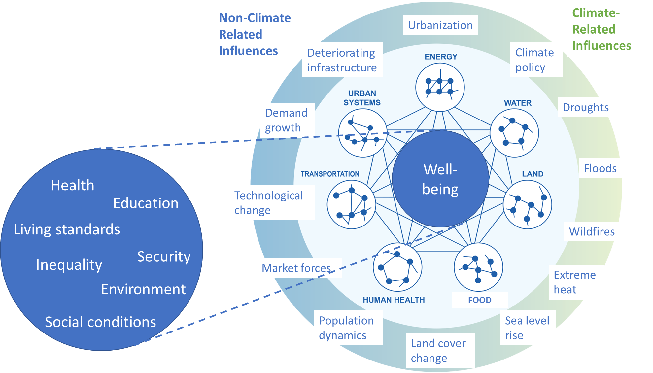
A Framework for Multisector Scenarios of Outcomes for
Well‐Being and Resilience
Objective
Propose an approach to scenario development that is organized around outcomes for well-being and resilience, cuts across issues and scales in multiple sectors, and draws on new systematic methods of scenario generation and discovery in multisector dynamic modeling.
Approach
Identifies a gap in scenario approaches, proposes a new focus on human well-being, and suggests a number of well-being metrics.
Lays out a vision for the use of exploratory modeling and scenario discovery to generate both a database of scenarios and a small set of representative scenarios for community use.
Proposes a process involving community engagement to identify well-being metrics, generate scenarios, and further model development.
Impact
Scenarios are an essential tool in exploring alternative plausible futures; the proposed approach would highlight scenarios that are most critical in understanding societal risks and responding to them.
Research derived from this outcome‐based scenario development approach would facilitate improved assessment of risks of and responses to a range of stressors and the multi‐sector interactions they generate.
*Based on NCA4, (Clarke et al, 2018)
The proposed scenario approach focuses on outcomes for human well-being resulting from a range of influences on multisector and dynamic interactions
O'Neill BC, Morris J, Lamontagne J, Weyant J, Wise M. 2024. “A Framework for Multisector Scenarios of Outcomes for Well‐Being and Resilience,” Earth's Future, 12, e2023EF004343.
DOI: 10.1029/2023EF004343
Notes:
http://www.pnnl.gov/science/highlights/highlights.asp?division=749

