Slide 1
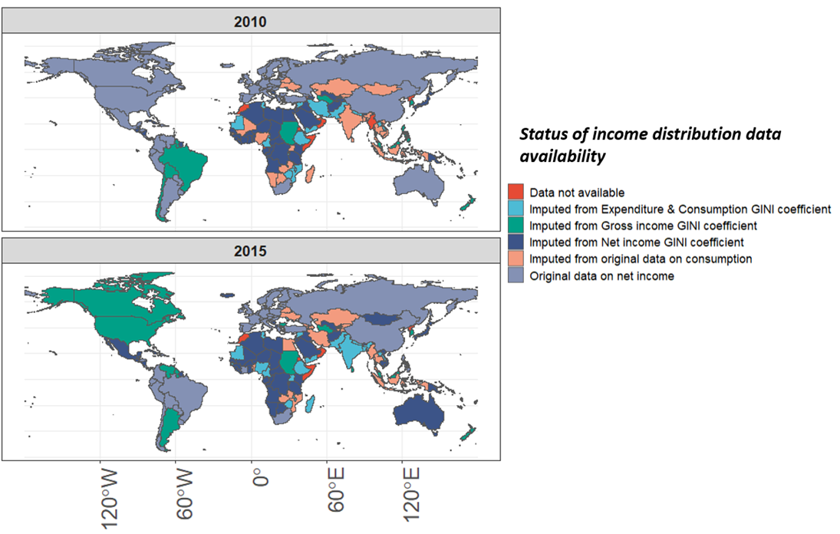
A new dataset of the net income distributions for 190 countries from 1958 to 2015
Objective
Develop a consistent dataset of income distributions across 190 countries from 1958 to 2015 measured in terms of net income. This dataset will enable calibrating multisector models and other classes of economic models with detailed data on income distributions.
Approach
We first identified observations by the country and year of net income deciles from all available datasets (Luxembourg Income Study Database (LIS) , World Bank PovCal tool and individual research studies). In doing so, we prioritized the LIS dataset given its high data quality on the net income distribution.
For countries and years in which there were no net income data but consumption data were available, the net income distribution was imputed from consumption distribution with a regression approach.
Where there were no net income or consumption data, but the Gini coefficient, a summary metric of the income distribution, was available, we imputed the net income distribution from this summary measure using a Principal Component Analysis (PCA) based approach.
Impact
To our knowledge there is no other dataset that presents consistent data at multiple geographical scales that have been documented in a peer-reviewed article.
This complete and harmonized dataset may be useful for efforts related to the modeling of the net income distribution.
Summary of data availability globally in our dataset for two years (2010 and 2015) where the color represents both data availability and how the data was sourced (i.e. through original data or imputation)
Narayan, K. B., O'Neill, B. C., Waldhoff, S., and Tebaldi, C.: A consistent dataset for the net income distribution for 190 countries and aggregated to 32 geographical regions from 1958 to 2015, Earth Syst. Sci. Data, 16, 2333–2349, https://doi.org/10.5194/essd-16-2333-2024, 2024. The complete dataset is also available on Zenodo here- https://zenodo.org/records/11222880

