Slide 1
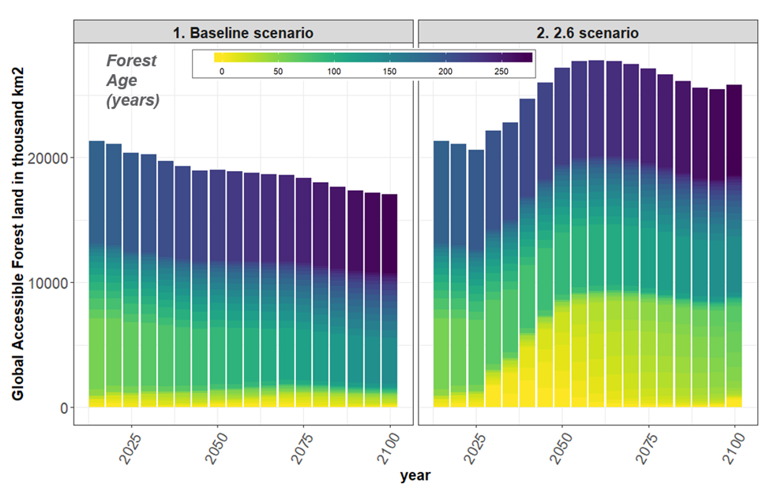
Dynamic representation of forest management and forest carbon in a long-term global multisector model
Objective
Implement a dynamic forest harvest model in a global multisector dynamics model to evaluate the interactions between forest management decisions and other sectors in the economy, focusing on the effects of changing timber prices and crop prices on forest plantation, clearing and harvest rotation ages.
Approach
We implement a novel dynamic forest harvest model in a global state of the art multi-sector dynamics model: the Global Change Analysis Model (GCAM).
We implement an approach that explicitly tracks forest age and generates rotation ages for forest harvest that are responsive to changes in wood prices, changes in forest age and regional preferences for forest rotation.
With our changes, the forest sector in GCAM competes for investment with other land use types in the future years and the model can produce forest rotation ages that are responsive to changes from other sectors of the economy.
Impact
Our baseline scenario results indicates that with the new forest harvest model, the current global wood product demand in GCAM can be met with minimal loss of old growth forest through the age-based harvest decisions.
We find that economic pressure for deforestation is a bigger driver of global forest change than wood harvests, especially in developing regions.
Under alternative scenarios where terrestrial carbon is valued and energy systems are reducing their carbon footprint, there is an increase in forest plantations in total. However, there can be decreases in forest cover in some regions where forest land competes with land for bio-energy crops.
Global accessible or unprotected forest cover by age in thousand km2 from 1990-2100 under the Baseline and a scenario where land use and land cover changes are consistent with reaching a global 2.6 W/m^2 radiative forcing in the Year 2100. Lighter colors thus represent younger forests with yellow representing new plantations in any given year (age 0). Darkening of colors represents preservation of forests which represents biomass accumulation.
Narayan, Kanishka B., Pralit Patel, Marshall Wise, Abigail Snyder, Kate Calvin, and Neal Graham. 2024. Seeing the Forest for the Trees: Implementing Dynamic Representation of Forest Management and Forest Carbon in a Long-Term Global Multisector Model. Environmental Research Letters 19 (104044). https://doi.org/10.1088/1748-9326/ad6ea3.

