Slide 1
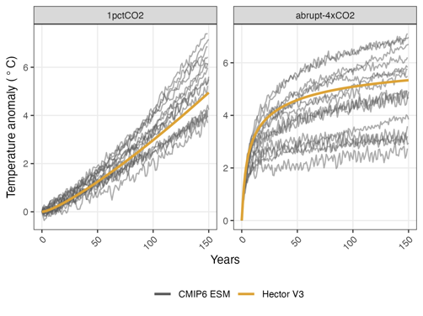
Hector V3.2.0: Functionality and performance of a simple climate model
Objective
Documents the latest release of the Hector, an open-source of reduced complexity climate-carbon cycle model that represents climate dynamics on a global annual basis
Approach
Provide details on the following: changes to Hector’s carbon cycle, new equations related to radiative forcing and temperature, model parameterization, and new model features
New features include implementing permafrost feedback and the carbon tracking feature, which enables Hector to track carbon as it moves through Hector’s terrestrial and ocean carbon cycle
Compare model output with historical observations and Earth System Model output to benchmark Hector and document model performance
Impact
This manuscript demonstrates that Hector historical results are consistent with CO2 concentrations and global mean surface temperature observations, making Hector a valuable tool that can be coupled with socioeconomic models and used to conduct studies focusing on climate-carbon and or human-Earth system interactions.
Hector's new capabilities enable researchers to explore a wider array of climate scenarios and integrate novel components tailored to specific research needs.
Hector temperature anomaly compared with CMIP6 participating Earth System Model output for two common diagnostic experiments, a 1% increase in atmospheric CO2 concentrations per year (left) and an abrupt 4x step increase in CO2 concentrations (right).
Dorheim, K., Gering, S., Gieseke, R., Hartin, C., Pressburger, L., Shiklomanov, A. N., Smith, S. J., Tebaldi, C., Woodard, D. L., and Bond-Lamberty, B.: Hector V3.2.0: functionality and performance of a reduced-complexity climate model, Geosci. Model Dev., 17, 4855–4869, https://doi.org/10.5194/gmd-17-4855-2024, 2024.
Notes:
http://www.pnnl.gov/science/highlights/highlights.asp?division=749

