Slide 1
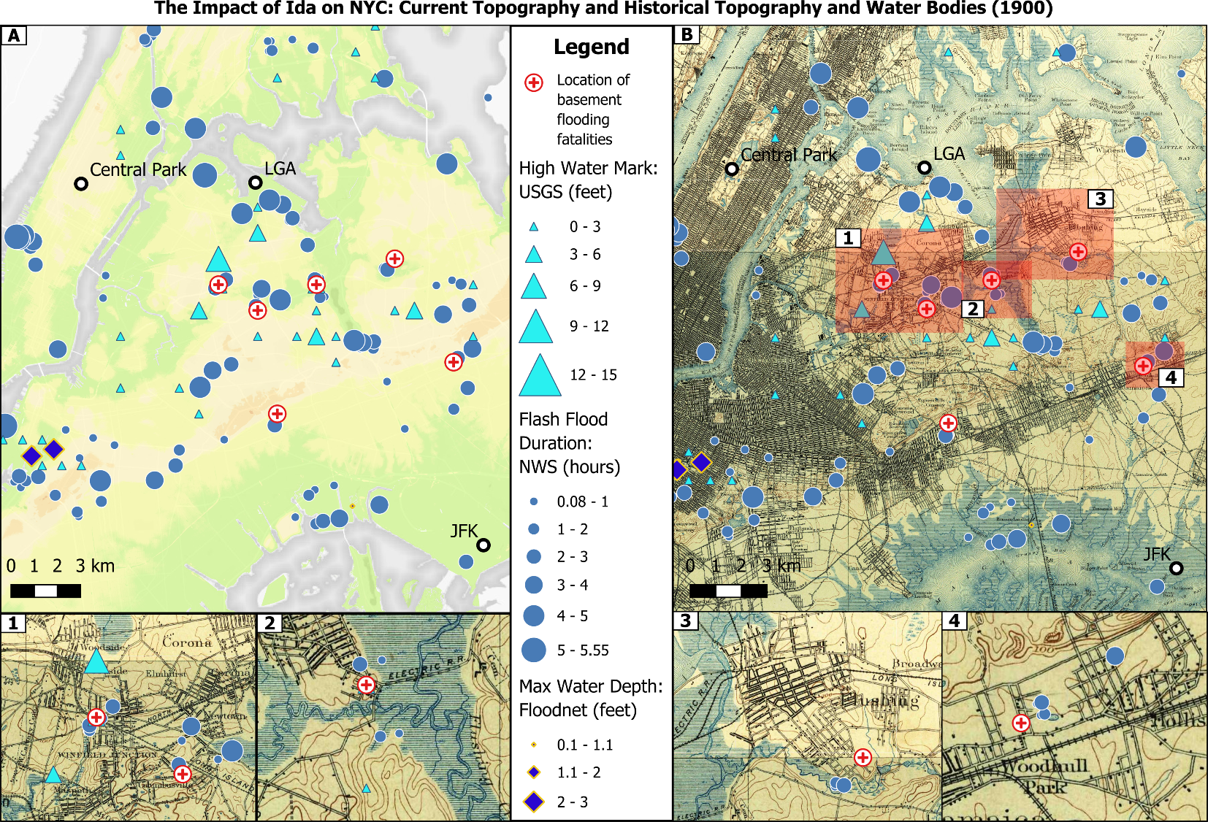
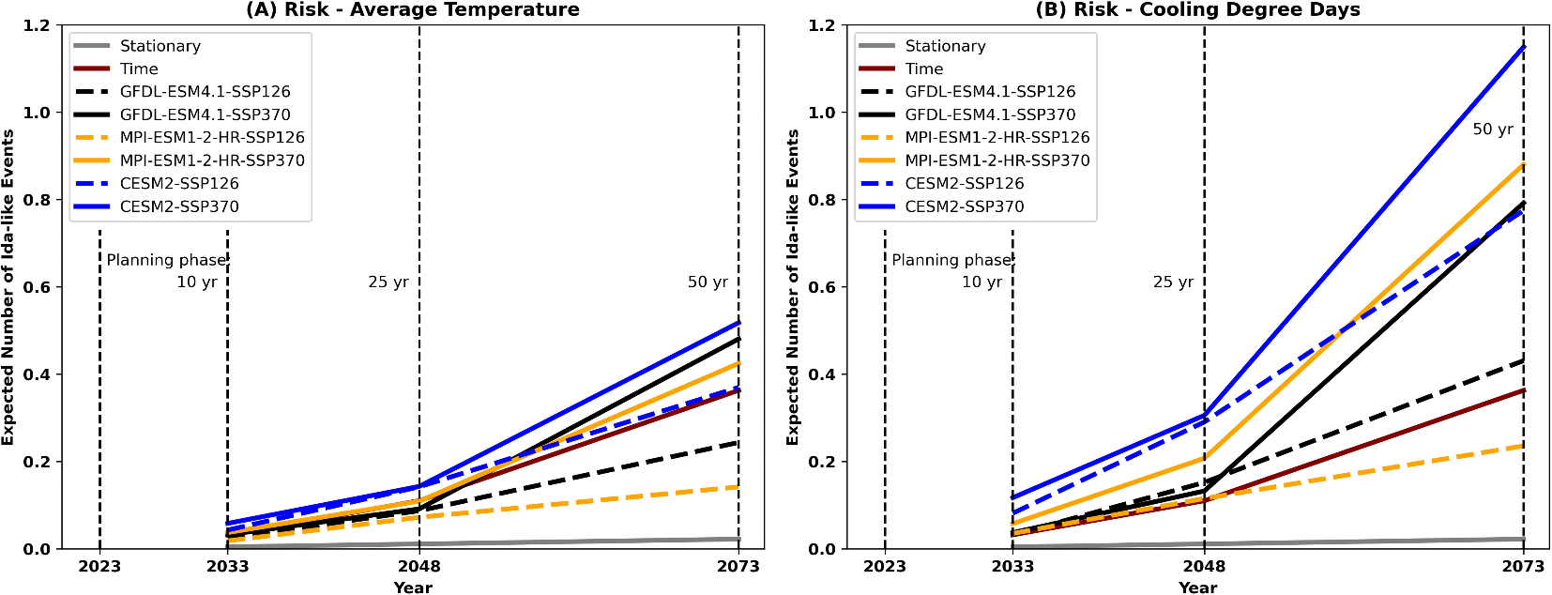
Increasing extreme hourly precipitation risk for New York City after Hurricane Ida
Objective: To contextualize Hurricane Ida’s record-breaking hourly intensity within the historical record as well as project its risk in the near- to medium-term future using nonstationary stochastic models.
Approach: We use a suite of traditional statistical tests to show how the significance of the extreme precipitation trend and the return period of Ida change with each year in the historical dataset. To complement existing climate modeling endeavors, we take a stochastic modeling approach to calculate nonstationary risk. We present a climate change-informed nonstationary method based on the Generalized Extreme Value distribution to project the risk of exceedance of another event of Ida’s magnitude and compare these values to a stationary one.
Results/Impacts: The projected aggregate reoccurrence risk of an event of Ida’s magnitude over time from the non-stationary models ranges from 4 to 52 times higher than the risk (0.045%) given by the stationary model. Using Cooling Degree Days as a covariate resulted in risks that were more than twice the magnitude than when using Tavg. Our results can be translated to potential future damage costs and encourage planning for such events that would be expected under climate change, reinforcing the pressing need for improved urban stormwater management systems that can handle higher intensity rainfall.
Mossel, C., Hill, S. A., Samal, N. R., Booth, J. F., & Devineni, N. (2024). Increasing extreme hourly precipitation risk for New York City after Hurricane Ida. Scientific Reports, 14(1), 27947. https://doi.org/10.1038/s41598-024-78704-9

