Slide 1
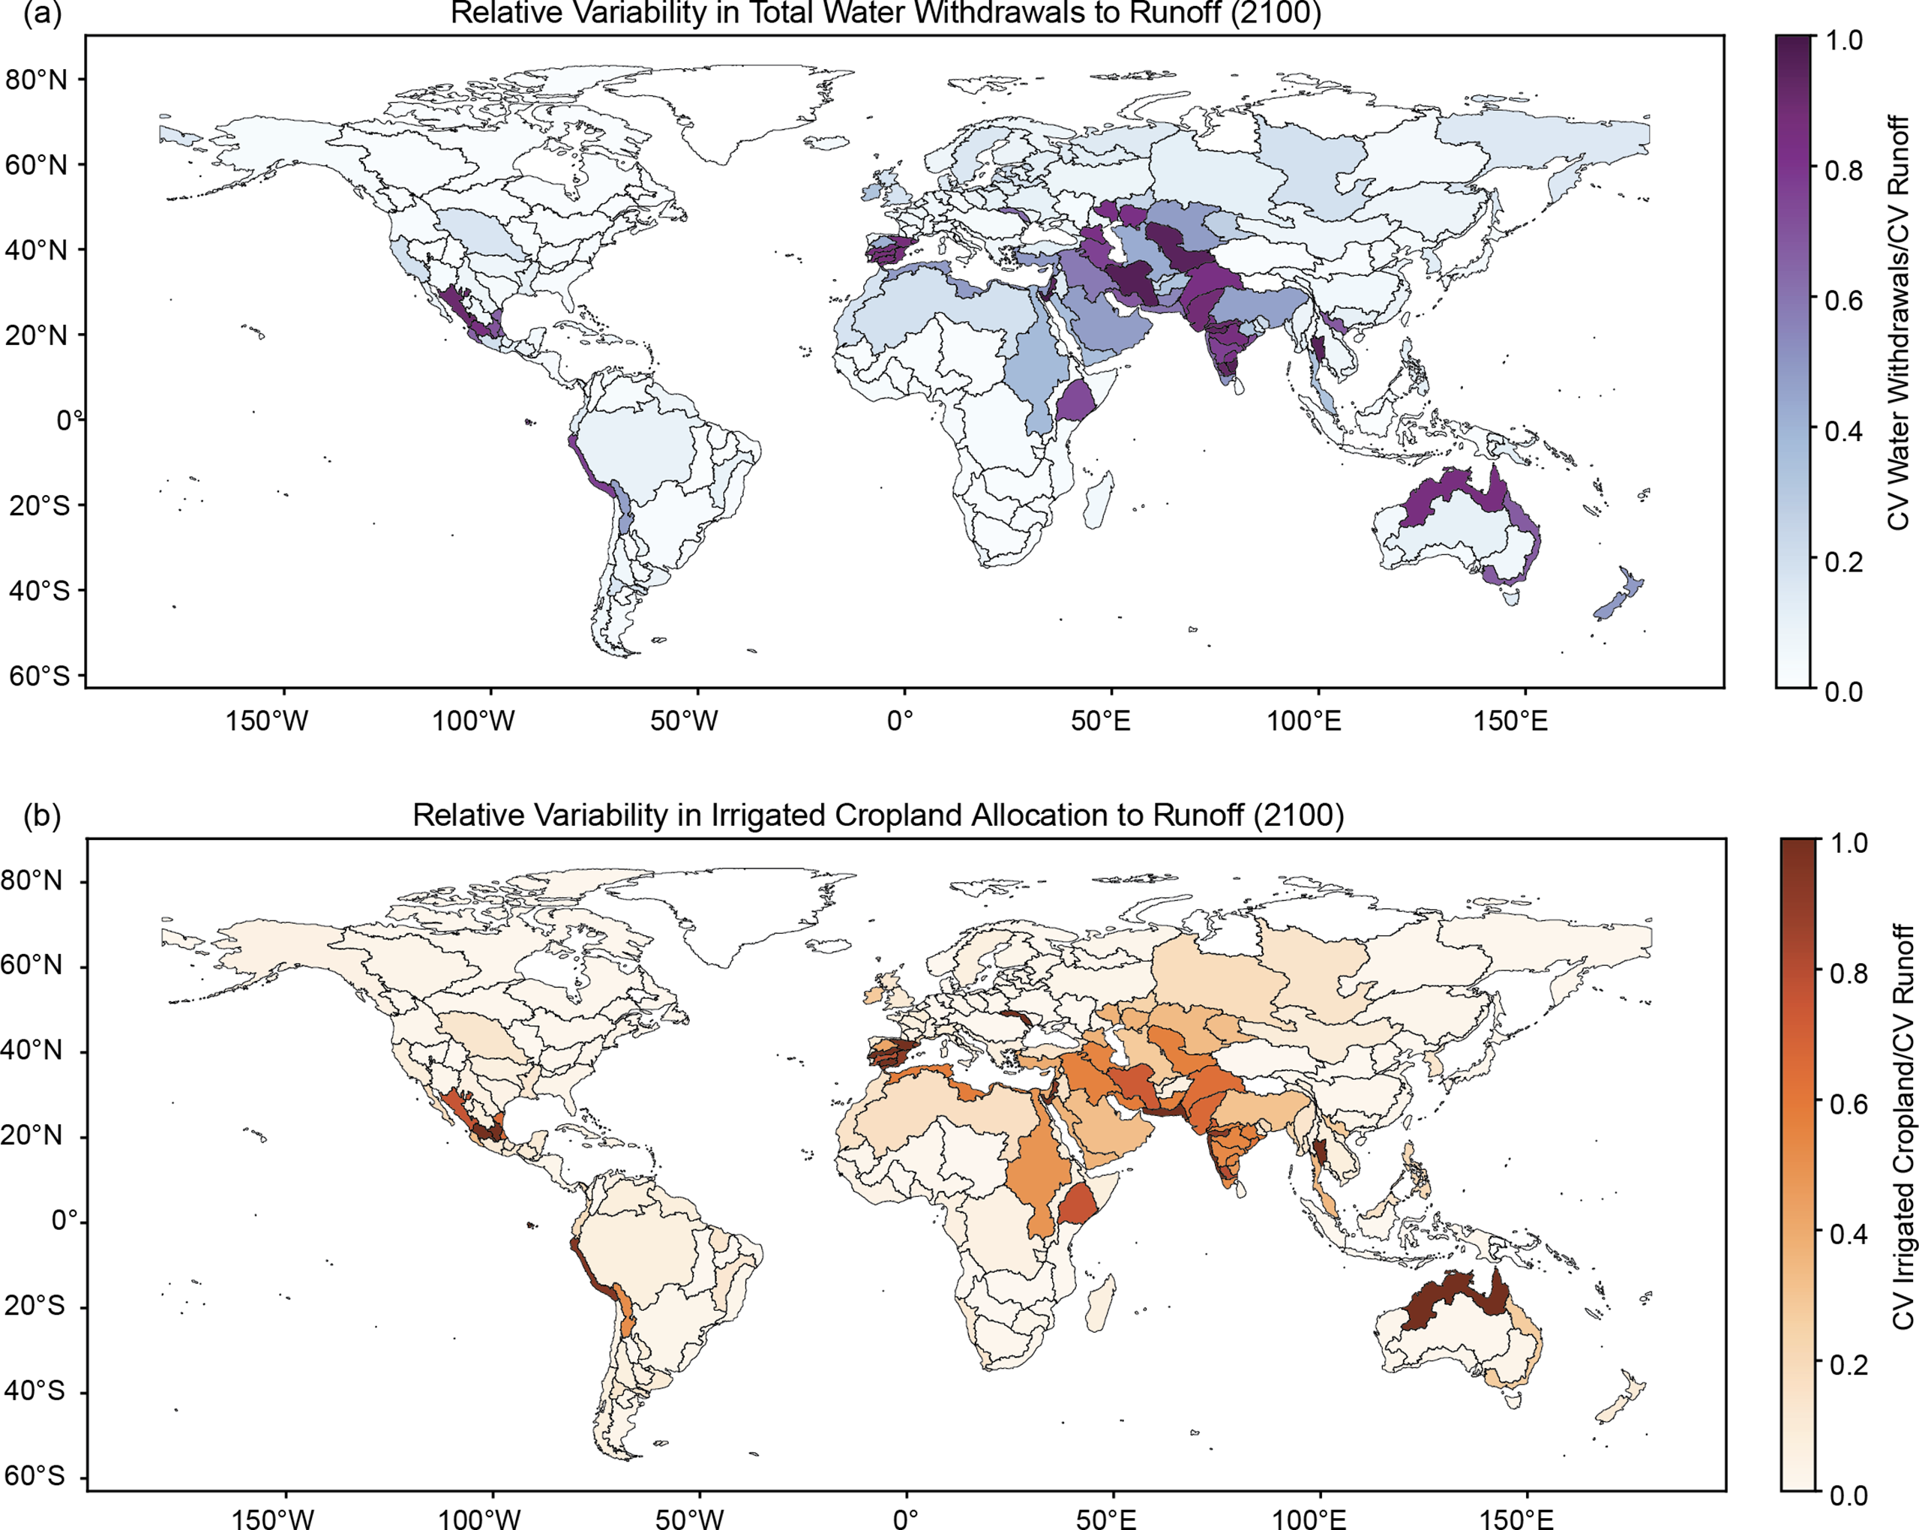
Exploring Multi-Sector Impacts of Uncertain Future Water Availability
Objective
Characterize the multisectoral impacts of future global hydrologic uncertainty by integrating stochastic hydrology with multisector dynamic human-environmental systems modeling.
Approach
Develop a computationally efficient stochastic watershed model with global coverage that generates a large ensemble of basin-scale runoff realizations, preserving historical mean, variance, and spatial correlation and improving representation of extreme runoff events compared to deterministic models.
Integrate the stochastic watershed model with the Global Change Analysis Model (GCAM), a multisector dynamics model, to propagate runoff variability impacts across energy, water, and land sectors.
Utilize GCAM results to identify basins and regions with significant impacts to water and land sectors given variability in future water supply.
Impact
Integration of stochastic modeling with multisector dynamics models reveals that variability in water supply can lead to substantial shifts in basin-scale cropland allocation and irrigation demands.
Variability in future runoff significantly impacts water and agricultural sectors, with basins that experience high rates of groundwater depletion, such as the Indus, showing increased sensitivity to this variability.
The figure highlights how variability in future renewable water supply impacts total water withdrawals and irrigated cropland globally in 2100. Darker colors represents basins whose water and agricultural sectors are most sensitive to uncertainty in water supply, thus indicating potential areas of interest for future water and land management.
Birnbaum, Abigail, Ghazal Shabestanipour, Mengqi Zhao, Abigail Snyder, Thomas Wild, and Jonathan Lamontagne. 2024. Characterizing the Multisectoral Impacts of Future Global Hydrologic Variability. Environmental Research Letters 19 (7): 074014. https://doi.org/10.1088/1748-9326/ad52af.

