Slide 1
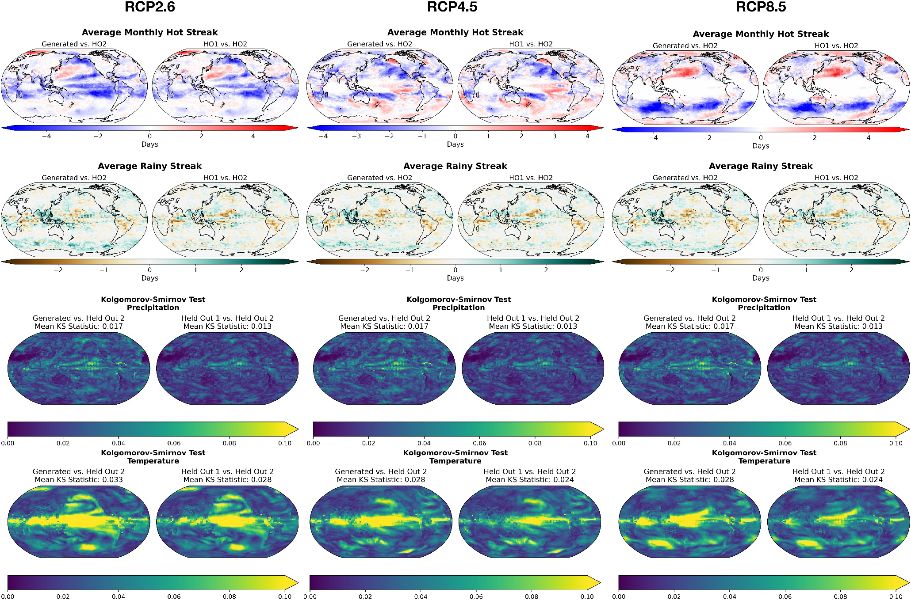
Machine Learning Model Generates Daily Weather from Monthly Averages
Objective
Propose a diffusion model emulating Earth System Model daily temperature and precipitation output, enabling more detailed and computationally cheaper analysis of climate, especially impact-relevant extreme metrics under future climate scenarios.
Approach
Utilize diffusion models, a class of generative deep learning models, to learn the relation between Earth System Model (ESM) outputs at the monthly and daily frequency by training on a limited number of ESM realizations that still encompass over time a wide range of radiative forcings.
Implement a denoising diffusion probabilistic model that learns to emulate the spatio-temporal behavior of ESMs, producing month-long samples of daily mean temperature or precipitation from monthly averages.
Utilize a 3D U-Net architecture with spatial and temporal convolutional blocks to separate and learn spatial and temporal structures, ensuring realistic climate sequence generation.
Impact
DiffESM effectively downscales monthly Earth System Model (ESM) outputs to daily temperature and precipitation values, closely matching the statistical characteristics of the original ESM data.
DiffESM has robust performance across different climate scenarios and periods, maintaining accuracy even when trained on limited number of realizations.
DiffESM's generated data exhibits sufficient variability, avoiding mode collapse and providing a realistic range of possible climate outcomes.
DiffESM can be coupled with existing emulators of ESM monthly temperature and precipitation output to provide relevant results under novel scenarios.
The above demonstrates the emulator performance under various RCP forcing scenarios, trained on output from the Institut Pierre-Simon Laplace (IPSL) model. DiffESM, trained on RCP8.5 data, is evaluated for lower-emission scenarios (RCP2.6 and RCP4.5) from 2080–2100. Results show accurate emulation of temperature and precipitation distributions across all scenarios, highlighting the emulator’s robustness despite training on only the highest emissions scenario.
Bassetti, Seth, Brian Hutchinson, Claudia Tebaldi, and Ben Kravitz. 2024. DiffESM: Conditional Emulation of Temperature and Precipitation in Earth System Models with 3D Diffusion Models. Journal of Advances in Modeling Earth Systems 16: e2023MS004194. https://doi.org/10.1029/2023MS004194.

