Slide 1
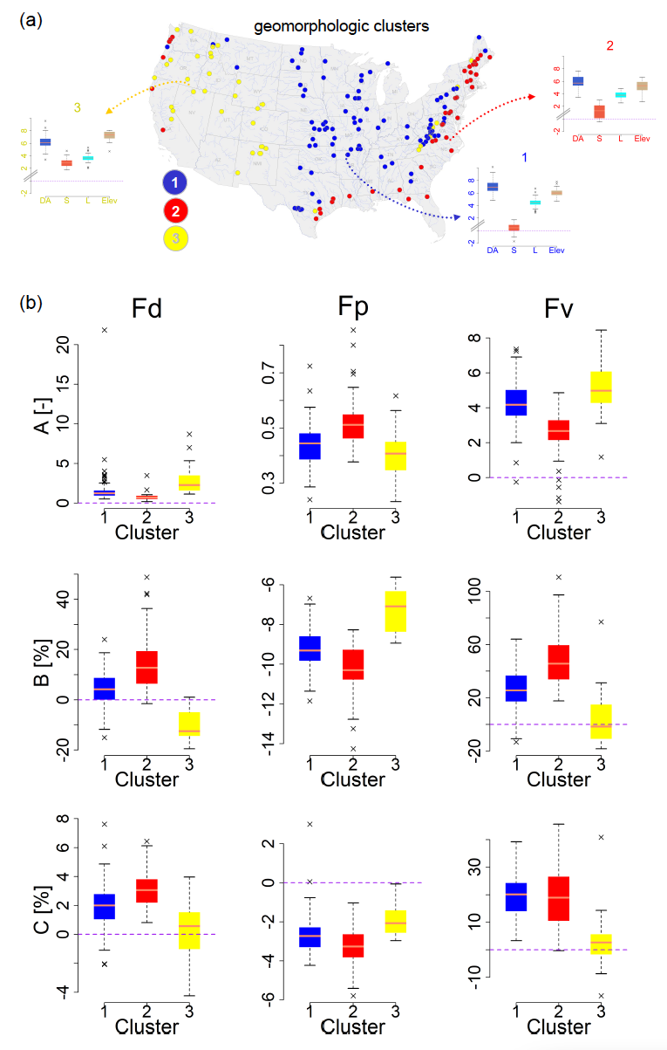
Scaling of Floods with Geomorphologic Characteristics and Precipitation Variability across the conterminous United States
Objective: To develop new scaling models to examine how the physical properties of catchments and precipitation patterns can inform flood attributes across the conterminous United States
Approach: We developed the laws of scaling of floods (duration, peak, volume) with geomorphologic characteristics of the basin (i.e., drainage area, slope, elevation) and precipitation patterns (rainfall accumulation, variability) using a multi-level Bayesian approach. The spatial organization of scaling exponents is also investigated. The baseline model quantifies the scaling of floods to geomorphologic characteristics. The dynamic model quantifies the scaling of floods to antecedent precipitation distribution which is further conditioned on geomorphologic characteristics.
Results/Impacts: Larger basins located at higher elevations are found to have decreasing scaling rates with flood peaks when interacting with the preceding precipitation patterns. Overall, low-elevation flat basins across the Eastern, Southern, and Northwestern US have a larger positive response to precipitation in amplifying flood attributes. This study advances flood predictions by better informing the flood attributes in the context of dynamical land-atmosphere perturbations.
Najibi, N., & Devineni, N. (2023). Scaling of Floods with Geomorphologic Characteristics and Precipitation Variability across the conterminous United States. Water Resources Research, 59, e2022WR032815. https://doi.org/10.1029/2022WR032815
Clustering of the scaling exponents

