Slide 1
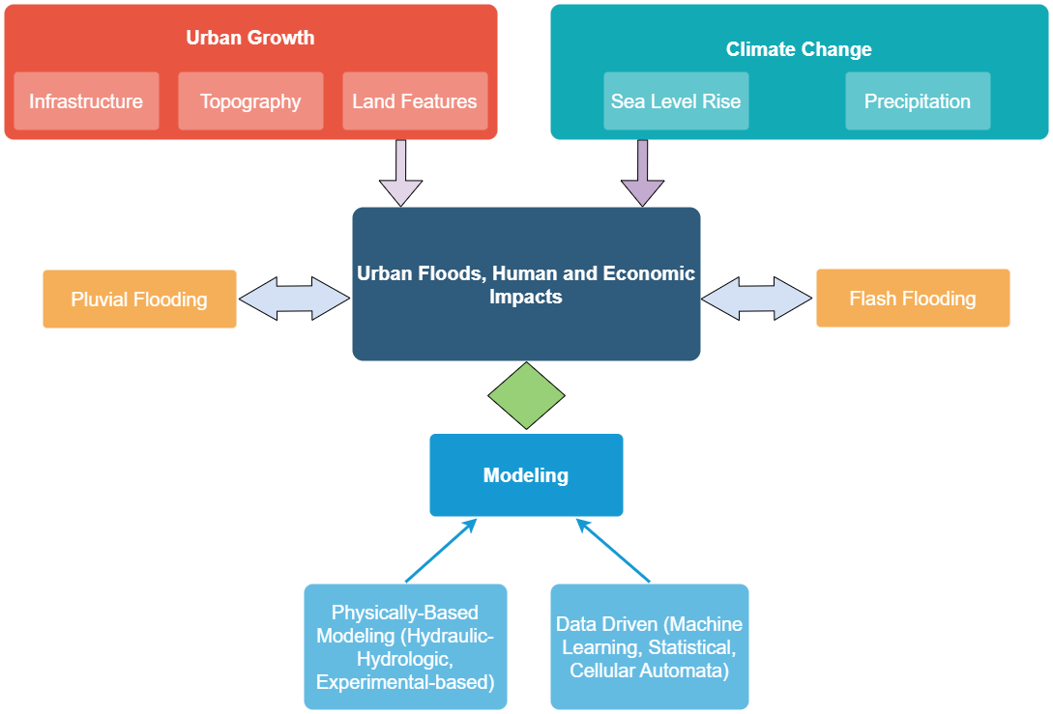



A Review of Recent Advances in Urban Flood Research
Objective: To presents a review of the recent trends in urban flood modeling, particularly highlighting the modern computationally-efficient hydraulic-hydrological models and the increasing use of data-driven models.
Approach: This review details the concepts, impacts, and causes of urban flooding, along with the associated modeling endeavors. Moreover, this review describes contemporary directions towards urban flood resolutions, including the more recent hydraulic-hydrologic models that use modern computing architecture and the trending applications of artificial intelligence/machine learning techniques and crowdsourced data. With approximately, 55% of the world’s population living in urban areas, the increase in extreme precipitation events will only exacerbate consequences. Thus, more than ever, urban flooding poses a severe threat to the international community. As a response to the urgency, this review has presented a holistic view on the subject of urban flooding.
Results/Impacts: With the main concepts, causes, impacts, and resolutions of urban flooding presented, this review may serve as a strategic starting point for researchers formulating additive ideas and methods, and it may assist as a guide or a primer of urban flood modeling approaches for scientists and engineers. A reference of utility is provided, as scientists and engineers are given an outline of the recent advances in urban flooding research.
Agonafir, C., Lakhankar, T., Khanbilvardi, R., Krakauer, N., Radell, D., & Devineni, N. (2023). A Review of Recent Advances in Urban Flood Research. Water Security, 19, 100141. https://doi.org/10.1016/j.wasec.2023.100141

