Slide 1
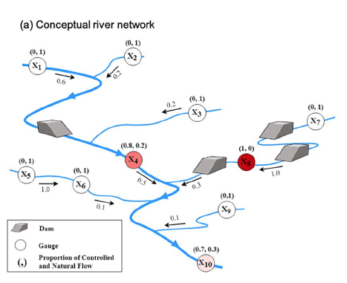
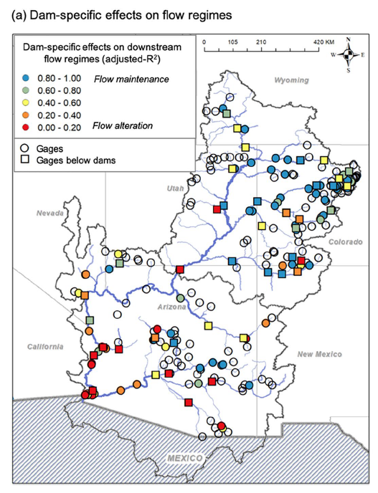
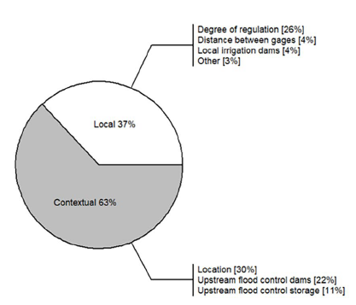


How Does Flow Alteration Propagate Across a Large, Highly Regulated Basin? Dam Attributes, Network Context, and Implications for Biodiversity
Objective: To understand how flow alteration propagates in river networks, as influenced by the location and characteristics of dams as well as the structure of the river network
Approach: We used a spatial Markov network model informed by 117 upstream-downstream pairs of monthly flow series (2003–2017) to estimate flow alteration from 84 intermediate-to-large dams in the Colorado River Basin. Using Least Absolute Shrinkage and Selection Operator regression, we then investigated how flow alteration was influenced by local dam properties (e.g., purpose, storage capacity) and network-level attributes (e.g., position, upstream cumulative storage).
Results/Impacts: Flow alteration was highly variable across the network, but tended to accumulate downstream and remained high in the main stem. Dam impacts were explained by network-level attributes (63%) more than by local dam properties (37%), underscoring the need to consider network context when assessing dam impacts. Our results advance the notion that basin-wide reoperation should be considered in any effort to mitigate flow alteration—a critical need in light of new damming in developing economies.
How does flow alteration propagate across a large, highly regulated basin? Dam attributes, network context, and implications for biodiversity. Earth's Future, 10, e2021EF002490. https://doi.org/10.1029/2021EF002490

