Slide 1
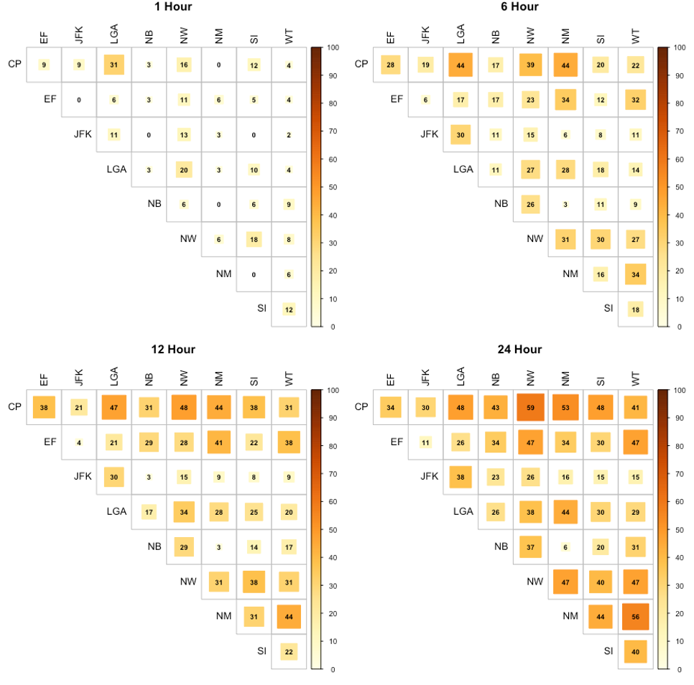
Technical note: Modeling spatial fields of extreme precipitation – a hierarchical Bayesian approach
Objective: To develop a new approach to modeling extreme regional rainfall by considering the spatial structure of extreme events
Approach: We introduce a hierarchical Bayesian model for the spatial distribution of rainfall corresponding to an extreme event of a specified duration that could be used with regional hydrologic models to perform a regional hydrologic risk analysis. An extreme event is defined if any gaging site in the watershed experiences an annual maximum rainfall event and the spatial field of rainfall at all sites corresponding to that occurrence is modeled.
Results/Impacts: Applications to data from New York City demonstrate the effectiveness of the model for providing spatial scenarios that could be used for simulating loadings into the urban drainage system. Insights as to the homogeneity in spatial rainfall and its implications for modeling are provided by considering partial pooling in the hierarchical Bayesian framework. For larger cities, a consideration of the drainage network and the spatial dependence in rainfall at different durations is important to consider, at least from the perspective of assessing the performance and resilience of the network and perhaps also for design considerations. Our models are simple enough that could directly explore whether or not and to what extent there was opportunity to pool regional information on extreme rainfall events to describe plausible spatial fields of extreme rainfall for urban areas.
Percent of simultaneous or near-simultaneous annual maxima events shown for the site-by-site comparison for nine sites and 1, 6, 12, and 24 h storms.
Rahill-Marier, B., Devineni, N., & Lall, U. (2022). Technical Note: Modeling Spatial Fields of Extreme Precipitation–A Hierarchical Bayesian Approach. Hydrology and Earth System Sciences, 26, 5685-5695. https://doi.org/10.5194/hess-26-5685-2022

