Slide 1
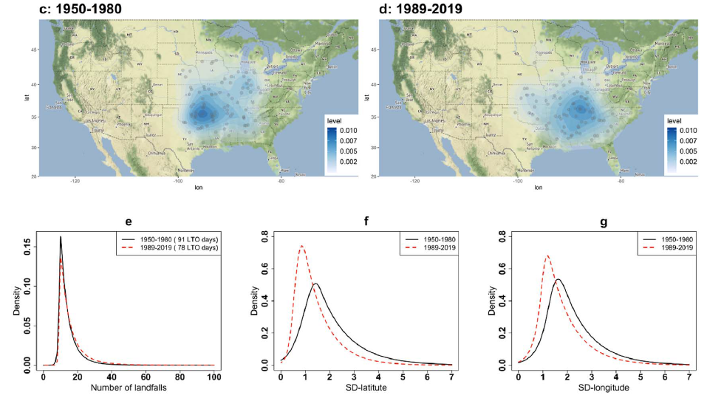
Examining the changes in the spatial manifestation and the rate of arrival of large tornado outbreaks
Objective: To assess the spatial and temporal characteristics of large tornado outbreak (LTOs) days, in which several counties were impacted by tornadoes rated F2(EF2) or greater on the Fujita (Enhanced Fujita) scale in one day.
Approach: A statistical evaluation of changes in the LTO clusters for two periods, 1950–1980 and 1989–2019, was performed. The overall inter-arrival rate of LTOs, and how it changed during successive 31-year climatological blocks between 1950–2019 was investigated using an exponential probability model.
Results/Impacts: We investigated the (E)F2+ tornado outbreaks, called large tornado outbreaks - LTOs, which simultaneously struck several US counties in a day. Seasonality analysis of the LTO days revealed that most LTOs (69%) happened in March-April-May, and there was no record during August. Wavelet transformation of the LTO time series illustrated significant power at the decadal time scale during the 1970–1980 and a strong inter-annual cycle potentially relevant to El-Ni o Southern Oscillation. Spatial analysis of LTOs reveals that their nucleus has been shifting to the Southeast during the recent 31-years compared to the earlier records. The cluster variance has significantly decreased in both latitude and longitude direction, suggesting a decrease in spatial dispersion. Using an exponential probability model for the LTO return time, we identified the arrival rate of LTOs during 40 successive 31-year periods. Results showed that LTOs became less frequent between 1950–1980 and 1977–2007. Understanding spatial and temporal shifts in large tornado outbreaks are of great importance, knowing that the recent Southeastward change could involve regions with a high density of mobile homes and forested terrain. The findings of this study have important implications for tornado risk management in the United States.
Examining the changes in the spatial manifestation and the rate of arrival of large tornado outbreaks. Environmental Research Communications, 4(2022), 021001. https://doi.org/10.1088/2515-7620/ac50c1

