Slide 1
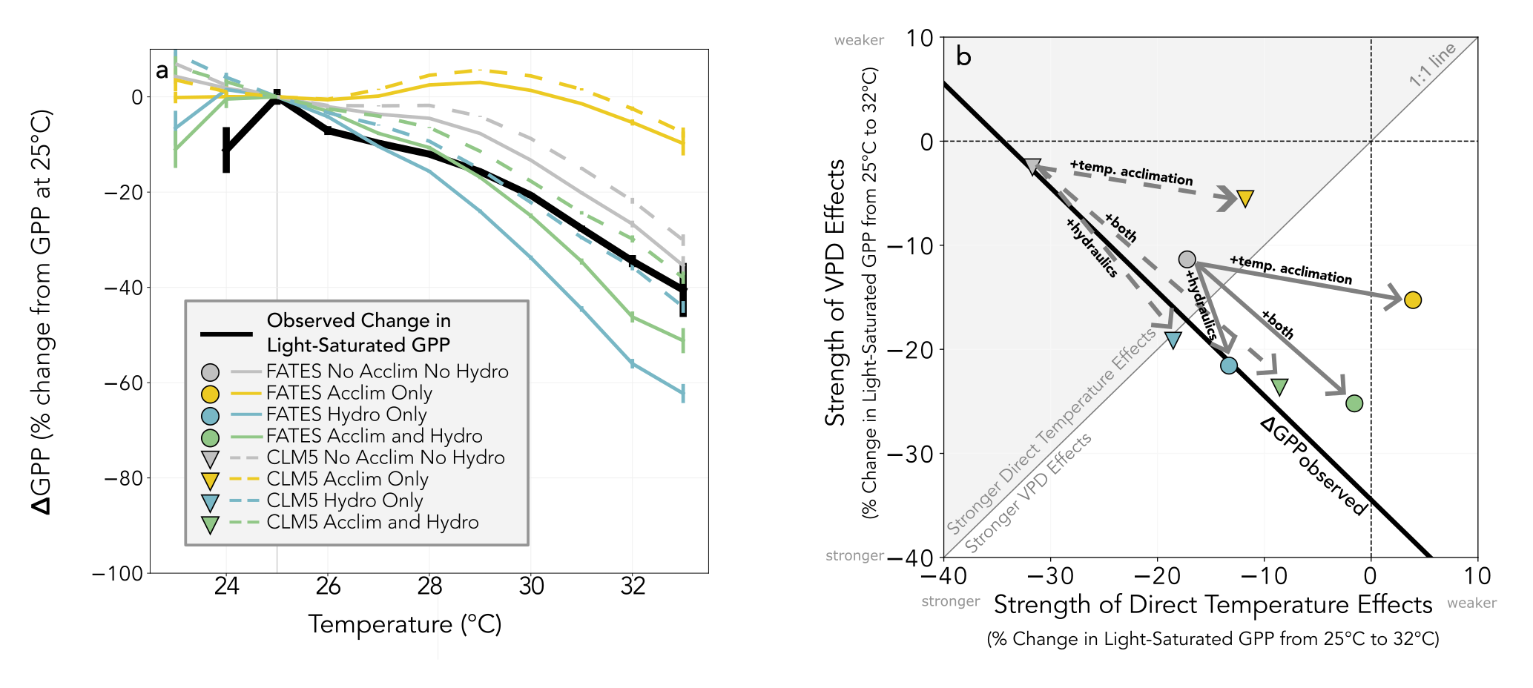

Tropical forest photosynthesis response to high temperatures
Scientific Achievement
Tropical forest photosynthesis appears to decline at high temperatures, but is it driven directly by hot temperatures or indirectly by changes in humidity? The authors disentangled the effects of hot temperatures and high vapor pressure deficits using creative model experiments to separate out the role of processes and uncertainty in process representation using two land surface models.
Significance and Impact
The authors found that including either both or neither of two processes (temperature acclimation of photosynthesis and dynamic plant hydraulics) matches the observed response of photosynthesis to hot temperatures similarly well, but gives diverging predictions for photosynthesis under future climate.
Research Details
Used the FATES model along with CLM to quantify the role of processes (temperature acclimation and dynamic plant hydraulics) as well as parametric uncertainty to disentangle the influence of hot temperatures and high vapor pressure deficit on photosynthesis in tropical forests.
C. M. Zarakas, A. L. S. Swann, C. D. Koven, M. N. Smith, and T. C. Taylor. Different model assumptions about plant hydraulics and photosynthetic temperature acclimation yield diverging implications for tropical forest gross primary production under warming. Global Change Biology, 30(9):e17449, 2024/09/20 2024.
https://doi.org/10.1111/gcb.17449

