Slide 1
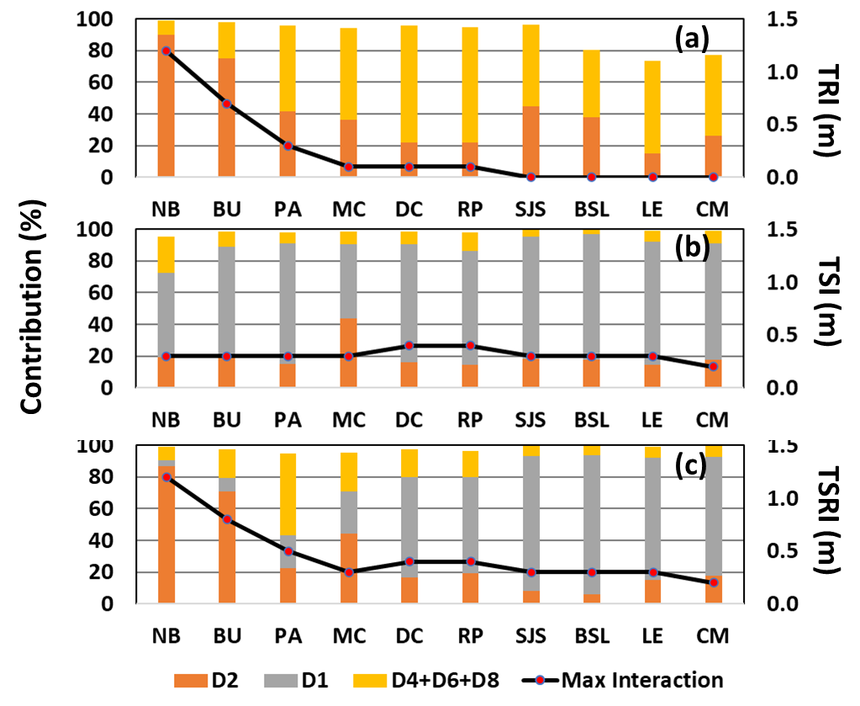
The Effect of Tide–Surge–River Interactions on Delaware Bay Estuary Coastal Flooding
Objective
Understand the effect of nonlinear interactions between tides, storm surges, and river flow on coastal flooding in the Delaware Bay based on high-resolution model simulations.
Approach
Develop a high-resolution coastal storm surge and inundation model for the Delaware Bay Estuary with input from river flow and hurricane wind field.
Simulate coastal flooding and validate the model for selected hurricanes, including Hurricane Irene, Hurricane Isabel, and Superstorm Sandy.
Evaluate the nonlinear interactions between tides, surges, and rivers and how they contribute to coastal compound flooding in the Delaware Bay Estuary.
Impact
The Delaware Bey Estuary shows three distinct zones: an upstream river-dominant zone, a downstream surge-dominated zone, and an in-between transition zone.
The effect of nonlinear interactions on total water level becomes more prominent during a compound flooding event, such as Hurricane Irene.
The transition zone shifts depending on the balance of river flow and storm surge.
The analysis shows the contributions of different factors and nonlinear interactions on compound flooding in the Delaware Bay Estuary. Figure shows peak values of (A) tide–river interaction (TRI), (B) tide–surge interaction (TSI), (C) tide–surge–river Interaction (TSRI) (black lines), and the percentage of relative contributions from different tidal bands (D2 – semi-diurnal [red]; D1 – diurnal [gray]; D4+D6+D8 – high-frequency [orange]) to the total variance of nonlinear interactions at 10 tidal gauges.
Xiao Z., Z. Yang, T. Wang, N. Sun, M. Wigmosta, and D. Judi. “Characterizing the nonlinear interactions between tide, storm surge, and river flow in the Delaware Bay Estuary, USA.” Frontiers in Marine Science, (2021). [DOI: 10.3389/fmars.2021.715557].

