Slide 1
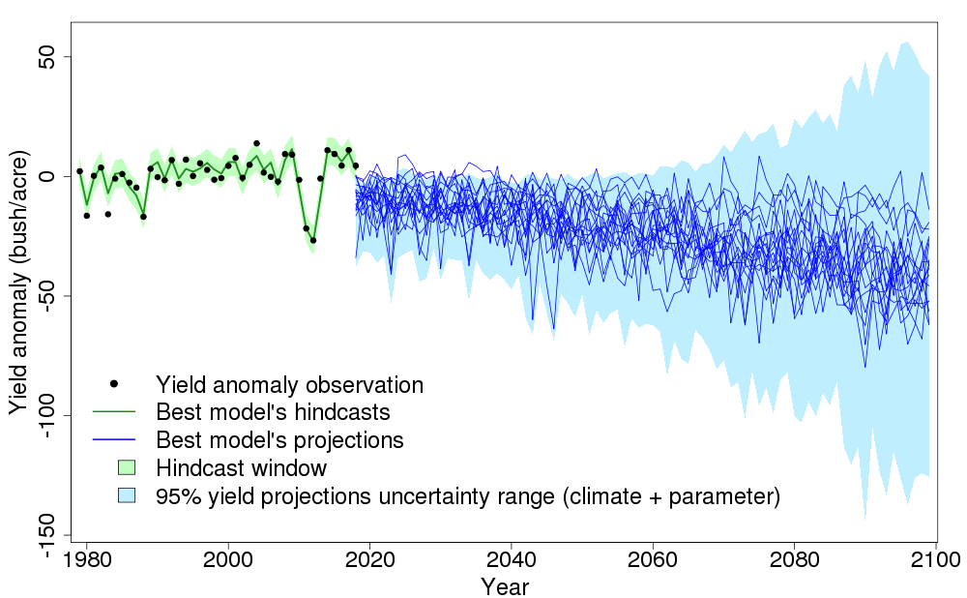
Considering uncertainties expands the lower tail of maize yield projections
Objective
Statistical models, built upon empirical relationships between observed quantities, are a common tool for projecting crop yields. However, the uncertainties associated with extreme low-yield outcomes are not well-studied. We quantify the key uncertainties in yield-weather model parameters and climate forcings for projections of maize yield under climate change.
Approach
Working with a well-studied statistical model of maize yield, we sample model parameter uncertainty using a pre-calibration method and climate forcing uncertainty using an ensemble of downscaled climate projections. We then quantify their relative importance using a cumulative uncertainty approach.
Figure: Annual mean yield hindcasts and projections under different methodological choices. The black dots are the yield observations. The green line is the best yield hindcast estimate. The deep blue lines are the best yield projection estimates under different climate forcings. The shaded areas are the 95% uncertainty ranges.
Impact
Model parameter uncertainty explains more yield variance than the climate forcing uncertainty. Sampling both uncertainty sources results in a longer tail of extreme low-yield projections. Incorporating a broader range of uncertainty sources thus provides an opportunity to better estimate the likelihood of very low crop yields due to extreme weather conditions.
Ye H, Nicholas RE, Roth S, Keller K (2021) Considering uncertainties
expands the lower tail of maize yield projections. PLoS ONE 16(11): e0259180. https://doi.org/10.1371/journal.pone.0259180

