Slide 1
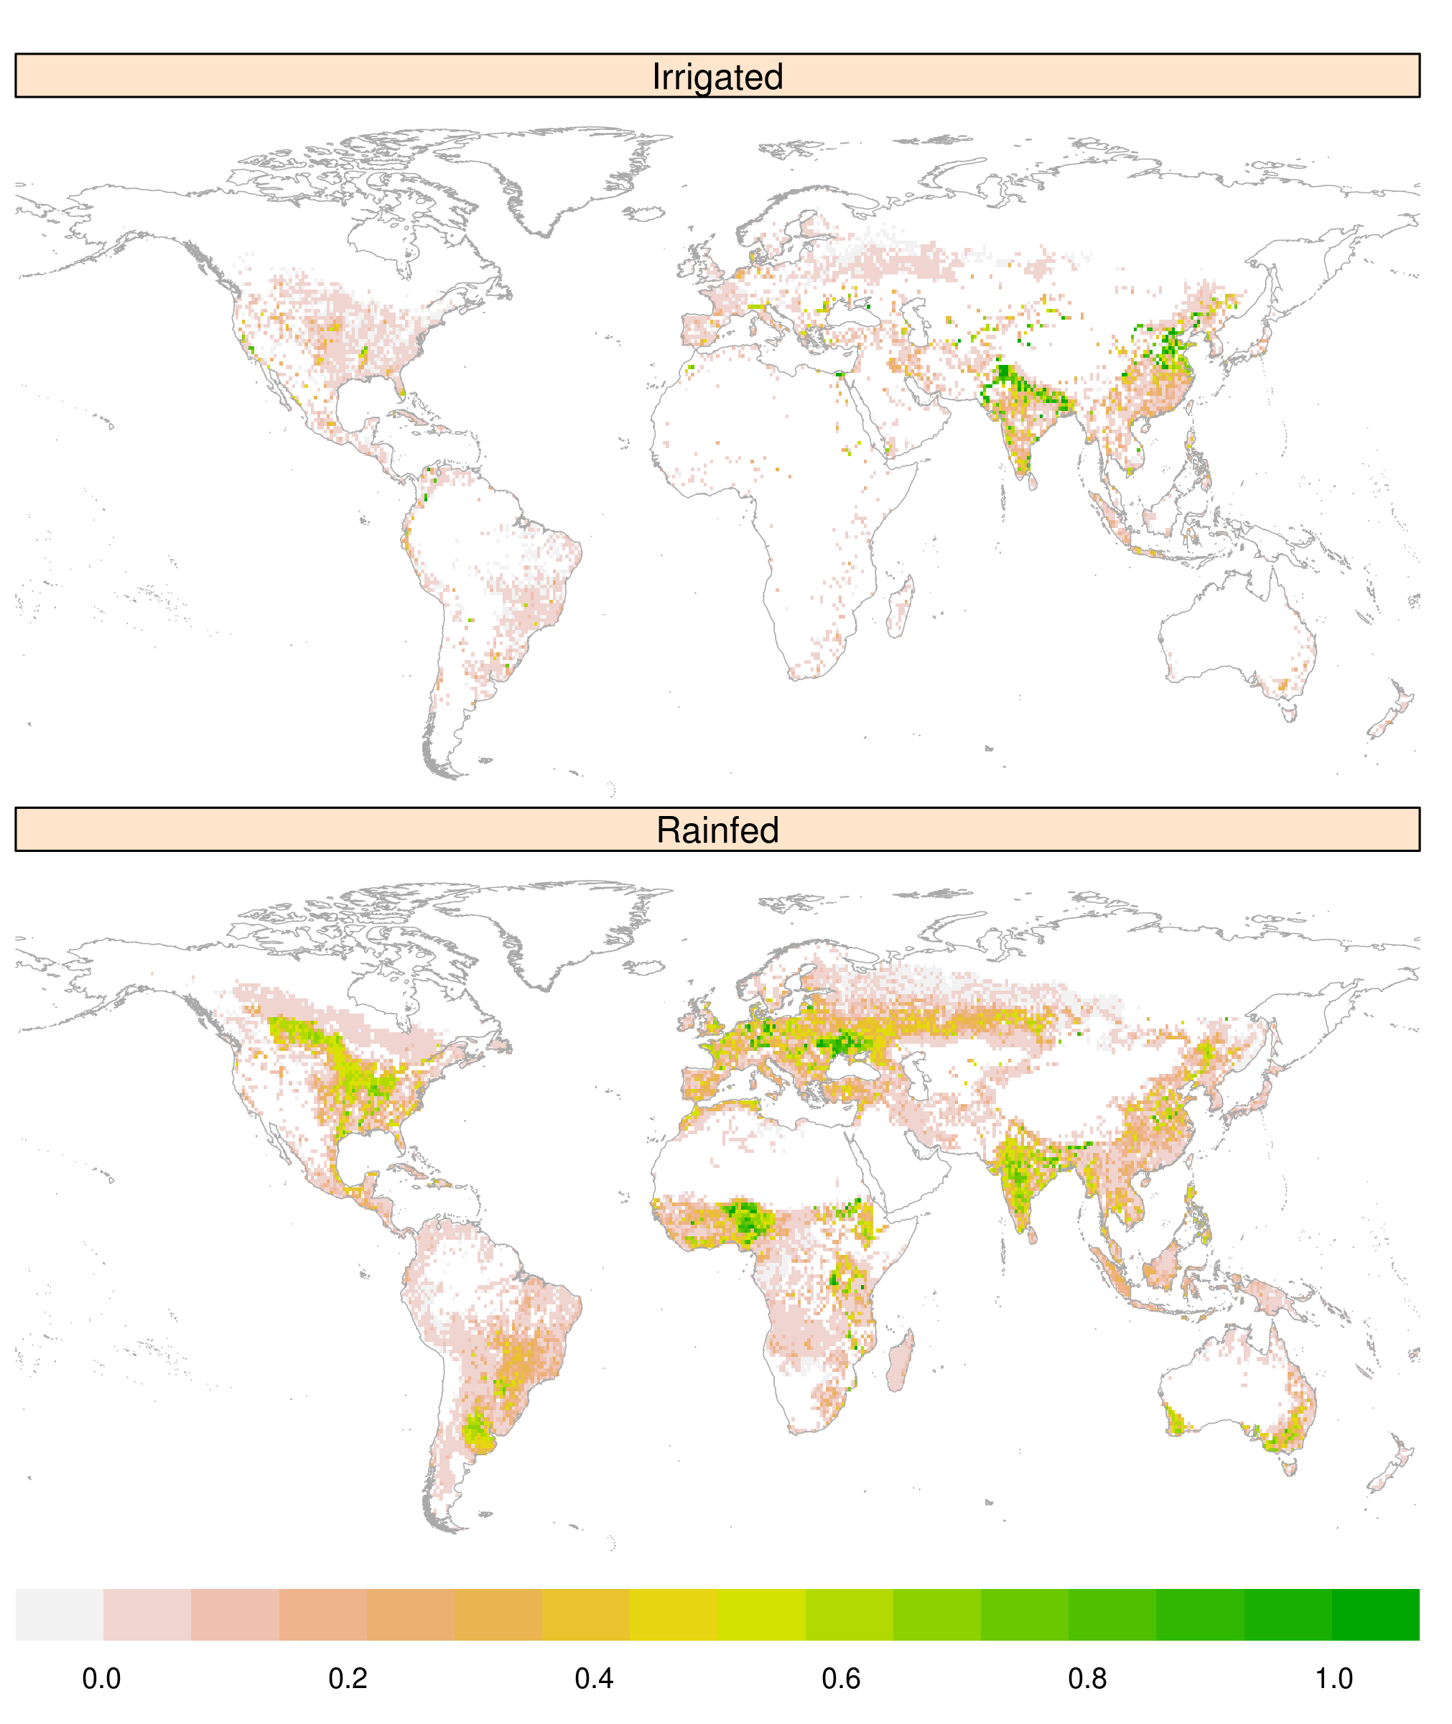
Global gridded crop harvested area, production, yield, and monthly physical area circa 2015
Objective
Crop data at high spatial and temporal resolution is a required input for many fine-scale Earth system and Multisector Dynamics models. While ongoing remote sensing projects are working to update these essential data from the most recent to more current timeframes, previous work only provided data up to year 2010. Here we develop a downscaling algorithm and apply it to year 2010 crop data to produce a gridded set of crop data for the year 2015 that can be used in gridded modeling.
Approach
We develop a downscaling algorithm that makes use of the most recent country-level crop statistics, grid cell crop distribution data, and spatially-distributed crop-specific planting and harvesting schedules to generate an internally consistent gridded dataset of crop harvested area, production, yield, and monthly physical area for 26 crops and crop categories.
Impact
Data produced by this work is publicly available, with Digital Object Identifiers (DOIs), and full metadata. Along with this paper – which details the methods employed to produce the data, and provides a link to a GitHub repository with associated code products – this data collection enables high resolution models to better represent the current state of agriculture.
Figure: (top) Year 2015 irrigated cropland as a fraction of each 5-minute grid cell. (bottom): same for rainfed cropland
Grogan, D., Frolking, S., Wisser, D. et al. Global gridded crop harvested area, production, yield, and monthly physical area data circa 2015. Sci Data 9, 15 (2022). https://doi.org/10.1038/s41597-021-01115-2.

