Slide 1



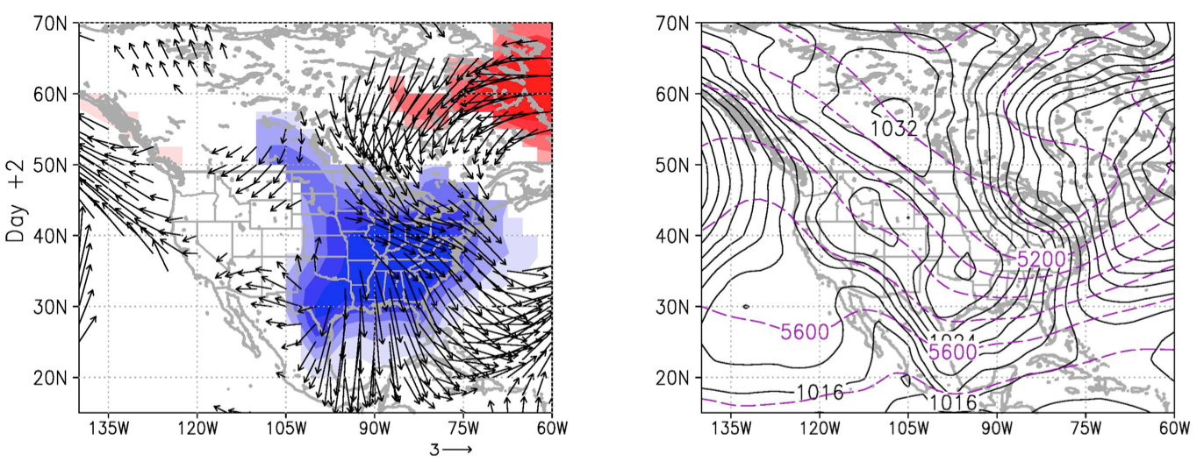



Anomalous Temperature Regime (ATR) Onset in the Southeast
The Role of the NAO circulation in Southeast Cold Air Outbreaks
(Left: 1000 hPa wind anomalies [m/s]; surface air temperature anomalies [K]
Right: sea level pressure [hPa]; 1000-500 hPa thickness [m])
  ♠ Low frequency modes provide a favorable environment for ATR onset
  ♥ ATR onset is triggered by specific synoptic-scale disturbance patterns
  ♣ Cold air outbreaks (CAO) involve air mass transport from high latitudes
  ♦ North Atlantic Oscillation contributes to both CAO onset and demise
Westby and Black (2015)

