Slide 1
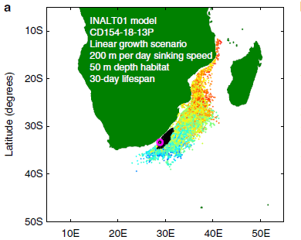
Ocean currents complicate reconstructions of past climate
Objective
Reconstruct the footprint of marine sediment cores by calculating back-trajectories of planktic foraminifera in eddying ocean models.
Footprint of a core site in the Agulhas Current (purple circle). Colored dots represent the location where the virtual forams start their 30-day life, color-coded for the recorded temperature along its trajectory. Black dots represent where foraminifera die and start to sink to the bottom of the ocean to end up at the core location.
Approach
Calculate trajectories of foraminifera in strongly eddying ocean models
Calculate these trajectories backward from specific core locations in the Agulhas region
Account for a range of life traits, like life span, habitat depth, and sinking speed.
Compare synthetic temperature records with proxies from real foram assemblages
Impact
Eddying ocean models can help interpret temperature reconstructions based on foraminifera-based proxies.
van Sebille, E., P. Scussolini, J. Durgadoo, F. Peeters, A. Biastoch, W. Weijer, C. Turney, C. Paris, and R. Zahn, 2015: Ocean currents generate large footprints in marine palaeoclimate proxies. Nature Communications, 6, 6521, doi:10.1038/ncomms7521.

