Slide 1
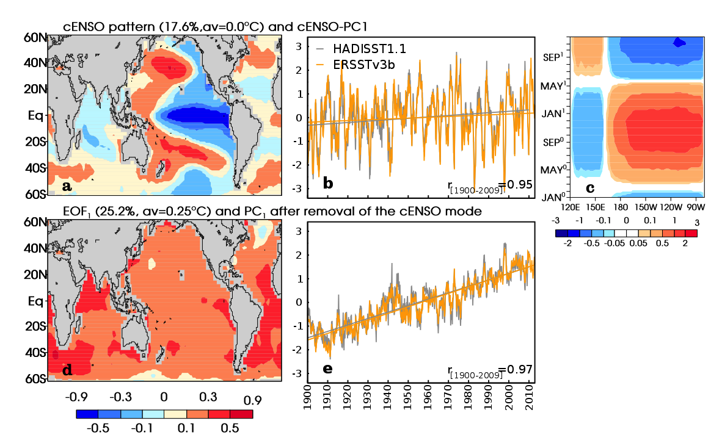
Relative contributions of mean-state shifts and ENSO-driven variability to precipitation changes in a warming climate
Objective
Investigate how regional precipitation (P) in the 21st century may be affected by changes in both ENSO-driven P variability and slowly-evolving mean P.
Research
Identify a time-invariant canonical ENSO (cENSO) pattern in observed SST data (Fig. 1).
Evaluate how well/when 33 coupled models replicate this pattern in simulations of the historical and future climate.
Compute the associated winter P responses to ENSO variability for the 20th century.
Assess whether these P responses change with global warming.
Impact
Models with better representation of the cENSO pattern produce more realistic winter P teleconnection patterns.
Teleconnections are more stationary during the 21st century in simulations with large amplitude of cENSO variability (Fig. 2).
In most regions, ENSO-driven P response will intensify in the future (Fig. 3), even if ENSO remains unchanged.
The model-predicted 21st century rainfall response to cENSO are decomposed into a 3-term sum. By examining the 3 terms jointly allows the identification of regions likely to experience future rainfall anomalies that are without precedent in the current climate (Fig. 4).
perturbed by other sources of variability
Tel patterns
quasi-stationary
cENSO pattern (18%)
Teleconnection stationarity
Fig. 2
Fig. 1
Amplitude of cENSO variability
LA NINA
EL NINO
20th century P response to ENSO events
Additional P response to ENSO in the future
Fig. 3
unprecedented
More P during El Nino events
Even more during El Nino events, relative to new mean state
Mean change
Less P during La Nina events
Historical
Future
Even less P during La Nina
Fig. 4: NE Pacific
Bonfils C, B Santer, T Phillips, K Marvel, R Leung, C Doutriaux, A Capotondi, 2015, Relative contributions of mean-state shifts and ENSO-driven variability to precipitation changes in a warming climate. Journal of Climate, 28, 9997-10013. doi: http://dx.doi.org/10.1175/JCLI-D-15-0341.1

