Slide 1
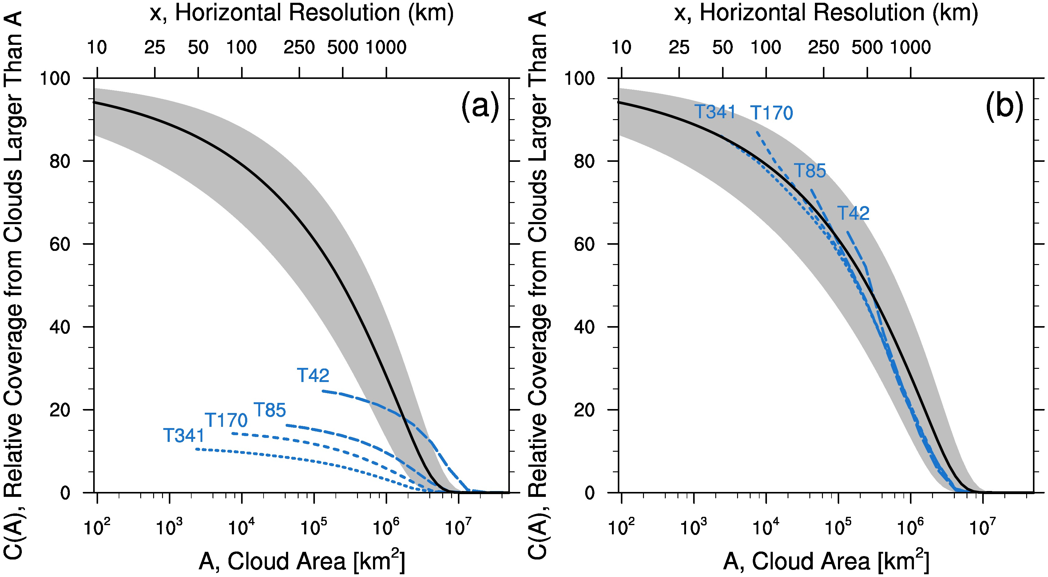
Defining Scale Aware and Uncovering Scale Incognizance in Atmospheric Models
Objective
Variable resolution (zooming) climate models should produce ‘better’ simulations in high-resolution regions; they should be scale aware. Almost no work has been done to define how a scale aware model should behave, and so it has been difficult to evaluate variable resolution models.
Modeled vs Expected: resolved cloud coverage
Modeled
Approach
Used cloud and precipitation observations to define how a scale aware model should behave
Compared this with output from idealized model simulations; models exhibit scale incognizance
Systematically tested model components to isolate the responsible model component
Expected
Impact
This work provides a framework for using scale-dependent behavior to define scale awareness. It has also led to model developers targeting microphysics parameterizations for improvement of scale aware behavior.
O’Brien, T. A., F. Li, W. D. Collins, S. A. Rauscher, T. D. Ringler, M. A. Taylor, S. M. Hagos, and L.-R. Leung, 2013: Observed scaling in clouds and precipitation and
scale incognizance in regional to global atmospheric models. Journal of Climate, In Press , doi:10.1175/JCLI-D-13-00005.1
Notes:
Wanda says that this is a general slide with no specific reference

