Slide 1
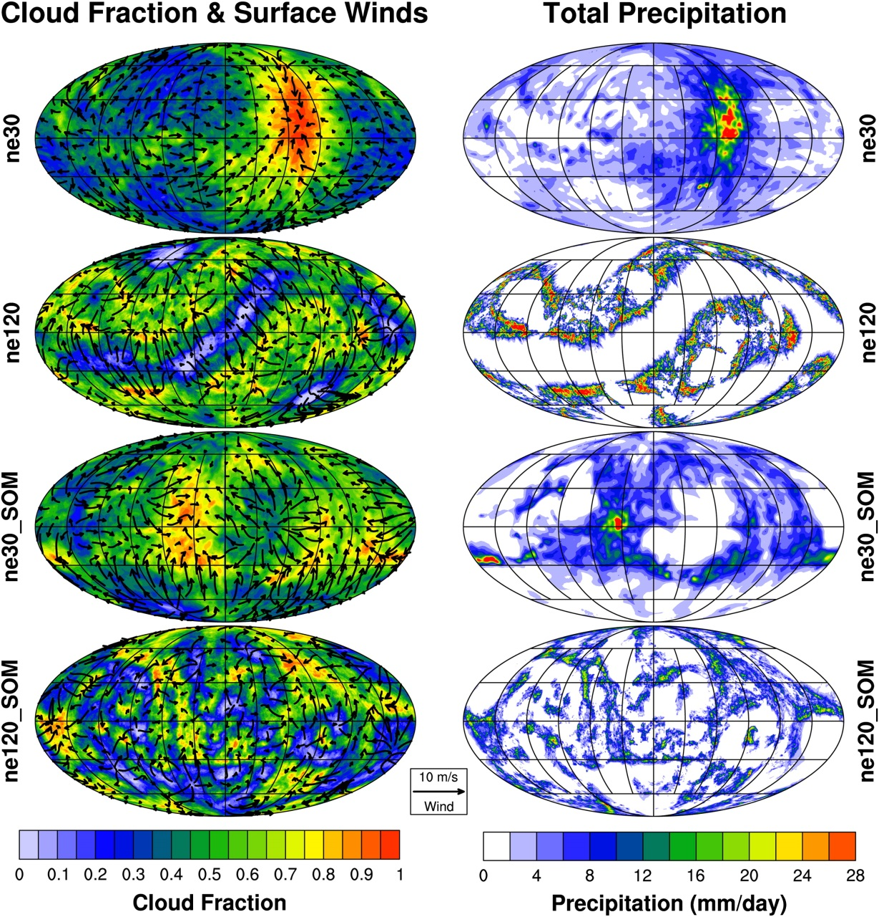
Global Radiative–Convective Equilibrium in the Community Atmosphere Model, Version 5
Kevin A. Reed, Brian Medeiros, Julio T. Bacmeister, and Peter H. Lauritzen: J. Atmos. Sci. http://dx.doi.org/10.1175/JAS-D-14-0268.1
OBJECTIVE
This study implements a radiative-convective equilibrium configuration in CAM5. This highly idealized state arises when the atmospheric state is determined through a balance of radiative cooling and convective heating. The paper describes the RCE configuration and shows the sensitivity of convective aggregation to resolution and lower boundary condition.
APPROACH
RCE is achieved by starting from an aquaplanet configuration and then additionally using a globally uniform SST, removing planetary rotation, and applying uniform insolation. The SST can also be calculated from a uniform slab-ocean model, allowing feedbacks between the atmosphere and surface.
IMPACT
The RCE framework provides an idealized approach to investigate model physics, especially in regard to the self-organization of convection. The study shows that both horizontal resolution and lower-boundary condition affect the manifestation of organized convection. RCE represents an additional tier in the hierarchy of global modeling that has only been recognized in the past couple of years.
Illustration of the (left) clouds and winds and (right) precipitation for the four simulations presented. Here ne30 is nearly 1-degree and ne120 is near 0.25-degree grid spacing.

