Slide 1
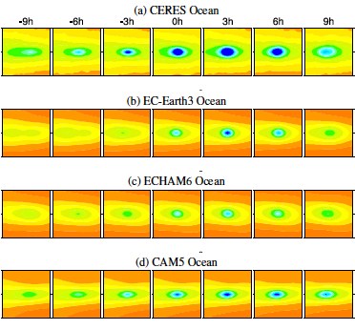
A Novel Technique to Compare Modeled and Observed Deep Convective Systems
An example composite of outgoing longwave radiation (OLR) centered on oceanic deep convective events in CERES observations (row 1) and in three climate models: EC-Earth (row 2), ECHAM6 (row 3), and CAM5 (row 4). Each composite region is 20˚x20˚ and is centered on the location of peak rain rate, which occurs at hour 0. The models capture some aspects of the observed OLR composite, but fail to reproduce some key features.
Objective: To apply a novel technique to systematically evaluate the ability of models to capture the observed spatio-temporal evolution of deep convective events and their effects on cloud properties, upper tropospheric water vapor, and outgoing longwave radiation.
Research: Composite deep convective events are constructed by averaging over many instances of intense rain rates. These composites are created at 3 hourly increments, allowing for a focused evaluation of the models’ ability to simulate the mean response of clouds, water vapor, and radiation in association with deep convection.
Impact: This work advances model evaluation beyond simple comparisons of climatological maps to assess the short-lived but critical phenomenon of deep convection, which is a challenge for large scale models to simulate accurately. This study identifies important compensating errors on short timescales that may be masked in climatological comparisons.
Reference: Johnston, M. S., Eliasson, S., Eriksson, P., Forbes, R. M., Gettelman, A., Räisänen, P., and Zelinka, M. D.: Diagnosing the average spatio-temporal impact of convective systems – Part 2: A model intercomparison using satellite data, Atmos. Chem. Phys., 14, 8701-8721, doi:10.5194/acp-14-8701-2014, 2014.
Notes:
Model evaluation commonly involves assessing the ability of models to capture observed climatological features. However, realistic climatologies can be achieved despite a poor simulation of important but short-lived phenomena. In this study, DOE- funded researchers perform a more stringent assessment of models by testing their ability to capture the observed spatio-temporal evolution of atmospheric properties and radiation in association with deep convection. They create composite deep convective events in observations and in three climate models at 3-hour resolution by averaging over many instances of intense rain rates. This allows for a focused and systematic evaluation of simulated deep convective events.
Despite having a larger climatological mean upper tropospheric relative humidity, the models closely capture the satellite-derived moistening of the upper troposphere following convection. Although simulated outgoing longwave radiation anomalies associated with deep convection are in reasonable agreement with observations, large errors in simulated cloud ice water content and cloud fraction suggest that such agreement with satellite-retrieved data is achieved in part due to compensating errors.

