Slide 1
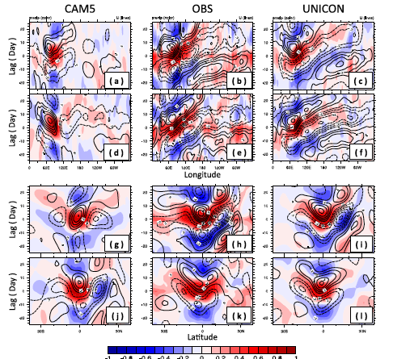
A Unified Convection Scheme, UNICON. Part II
OBJECTIVE
A unified convection scheme (UNICON) is implemented into the Community Atmosphere Model, version5 (CAM5), and tested in single-column and global simulations forced by observed sea surface temperature
APPROACH
Compared to CAM5, UNICON substantially improves the single-column simulations of stratocumulus-to cumulus transition and shallow and deep convection cases. The global performance of UNICON is similar to CAM5 with a relative spatiotemporal root-mean-square error (RMSE) of 0.777 (0.755 in CAM5) against the earlier version of the model (CCSM3.5).
IMPACT
The notable improvements in the UNICON-simulated climatologies over CAM5 are seasonal precipitation patterns (i.e., monsoon) over the western Pacific and South Asia, reduced biases of cloud radiative forcing in the tropical deep convection regions, aerosol optical depth in the tropical and subtropical regions, and cumulus fraction and in-cumulus condensate. In addition to the climatology, UNICON significantly improves the simulation of the diurnal cycle of precipitation and the Madden–Julian oscillation (MJO).
FIG. 20. The lead–lag correlations of 20–100-day bandpass-filtered, daily
PRECT (color shading) and U850 (solid dashed line) correlated to the
daily time series of bandpass-filtered PRECT at (08, 908E) as a function
of (a)–(f) longitude and (g)–(l) latitude during (a)–(c),(g)–(i) May–October and (d)–(f),(j)–(l) November–April from (center) the GPCP PRECT and the NCEP–NCAR reanalysis of U850 during January 1996–December 2008,(left) CAM5, and (right) UNICON
Park , Sungsu, 2014: A Unified Convection Scheme, UNICON.Part Ii.,JAS 71, 3931-3973, DOI: 10.1175/JAS-D-13-0234.1.

