Slide 1
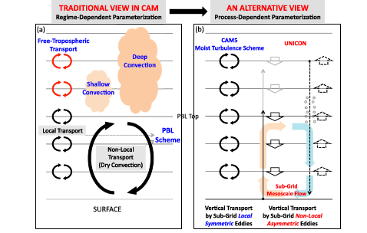
A Unified Convection Scheme, UNICON. Part I
OBJECTIVE
This study formally develops a new unified convection scheme (UNICON) that parameterizes relative (i.e., with respect to the grid-mean vertical flow) subgrid vertical transport by nonlocal asymmetric turbulent eddies.
APPROACH
UNICON is a process-based model of subgrid convective plumes and mesoscale organized flow that does not rely on any quasi-equilibrium assumptions such as convective available potential energy (CAPE) or convective inhibition (CIN) closures. In combination with a relative subgrid vertical transport scheme by local symmetric turbulent eddies and a grid-scale advection scheme, UNICON simulates vertical transport of water species and conservative scalars without double counting at any horizontal resolution. UNICON simulates all dry–moist, forced–free, and shallow–deep convection within a single framework in a seamless, consistent, and unified way.
IMPACT
The combined subgrid parameterization of diagnostic convective updraft and downdraft plumes, prognostic subgrid mesoscale organized flow, and the feedback among them remedies the weakness of conventional quasi-steady diagnostic plume models—the lack of plume memory across the time step—allowing UNICON to successfully simulate various transitional phenomena associated with convection (e.g., the diurnal cycle of precipitation and the Madden–Julian oscillation).
Pictorial description of the difference
between the conventional approach to
convective parameterization (left) and
UNICON (right)
Park , Sungsu, 2014: A Unified Convection Scheme, UNICON.Part I.,JAS 71, 3902-3930, DOI: 10.1175/JAS-D-13-0233.1.

