Slide 1
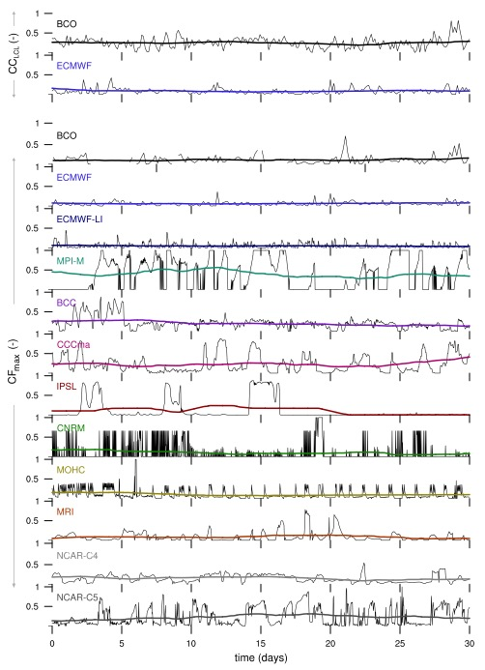
The behavior of trade-wind cloudiness in observations and models: The major cloud components and their variability
Louise Nuijens, Brian Medeiros, Irina Sandu, Maike Ahlgrimm: JAMES. http://dx.doi.org/10.1002/2014MS000390
OBJECTIVE
This study explores how well climate models represent the observed components of trade-wind clouds and their variability. Particularly whether models have similar cloud structure to that observed, including the omnipresence of cloudiness near the LCL and variable cloudiness near the inversion. The timescales associated with the cloudiness are also evaluated.
APPROACH
The analysis uses the single-timestep output of models which is available at selected locations as part of CMIP5. Nine models provide this output. Additionally, high-resolution short-range forecasts obtained with the ECMWF IFS are used for an area equivalent to the size of a climate model grid box. The location chosen is nearby or upstream of the island of Barbados, and comparisons are to those from the Barbados Cloud Observatory.
IMPACT
The models reveal large differences in their mean cloud profiles. Many models fail to produce the observed cloud structure. On fast time scales, almost all models have large biases in their cloud fraction profiles. Some models only produce bottom- or top-heavy profiles, alternating cloud formation between levels. They produce too much variability near the cloud-base, and it is contained on longer time scales than observed. This suggests that models do not capture turbulence and convective processes that appear to constrain cloudiness near the LCL in nature. Instead, they appear sensitive to processes that act on larger scales (longer time scales).
An arbitrary 30 day time series of cloudiness from BCO data, the ECMWF model, and climate models is shown. For the BCO and ECMWF, both CC_{LCL} and CF_{p} are shown, whereas for the other models only CF_{p} is shown. The thick colored lines represent a 10-day running average.

