Slide 1



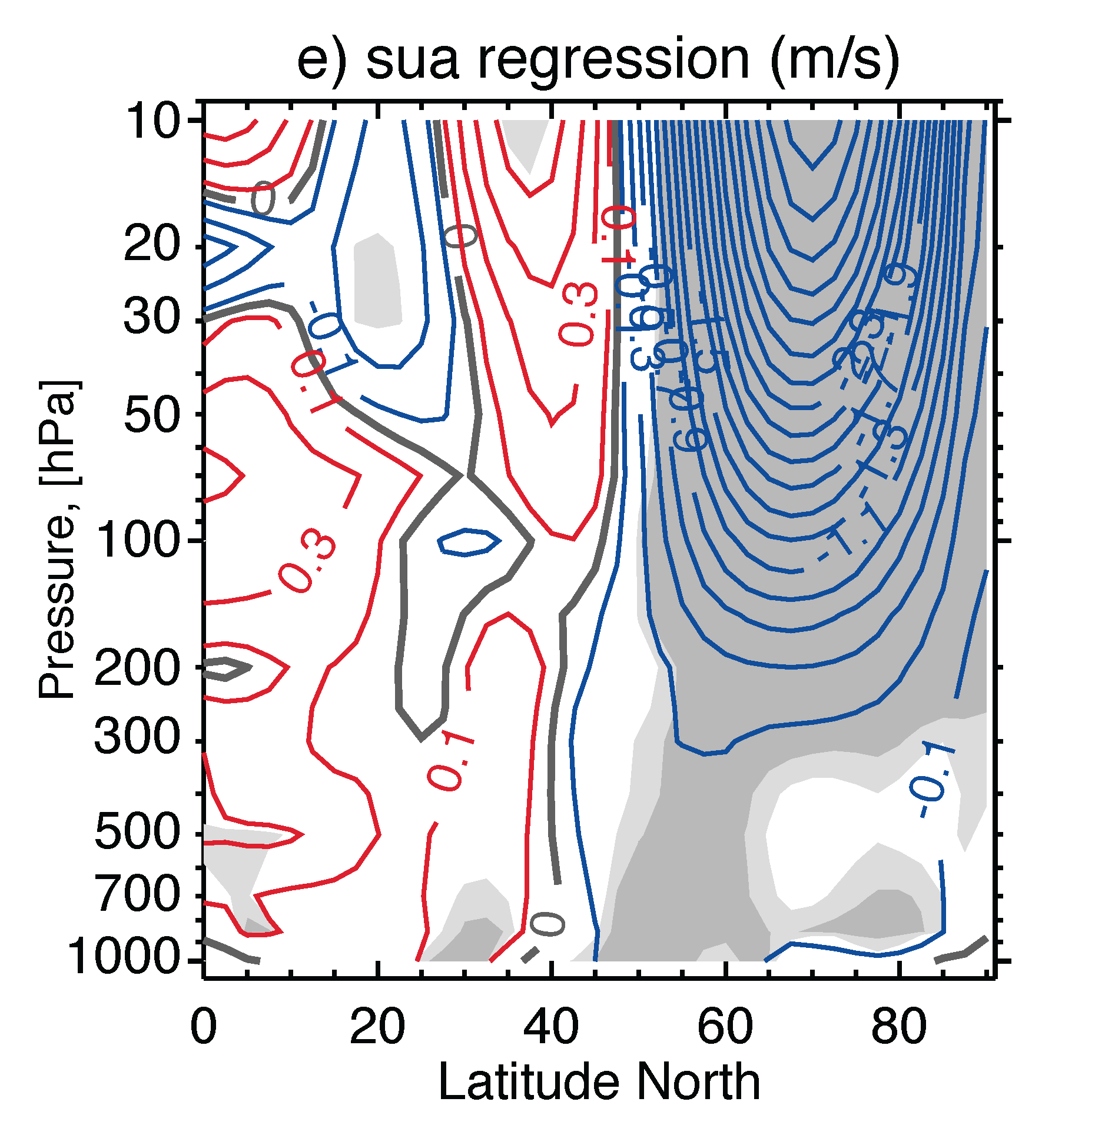
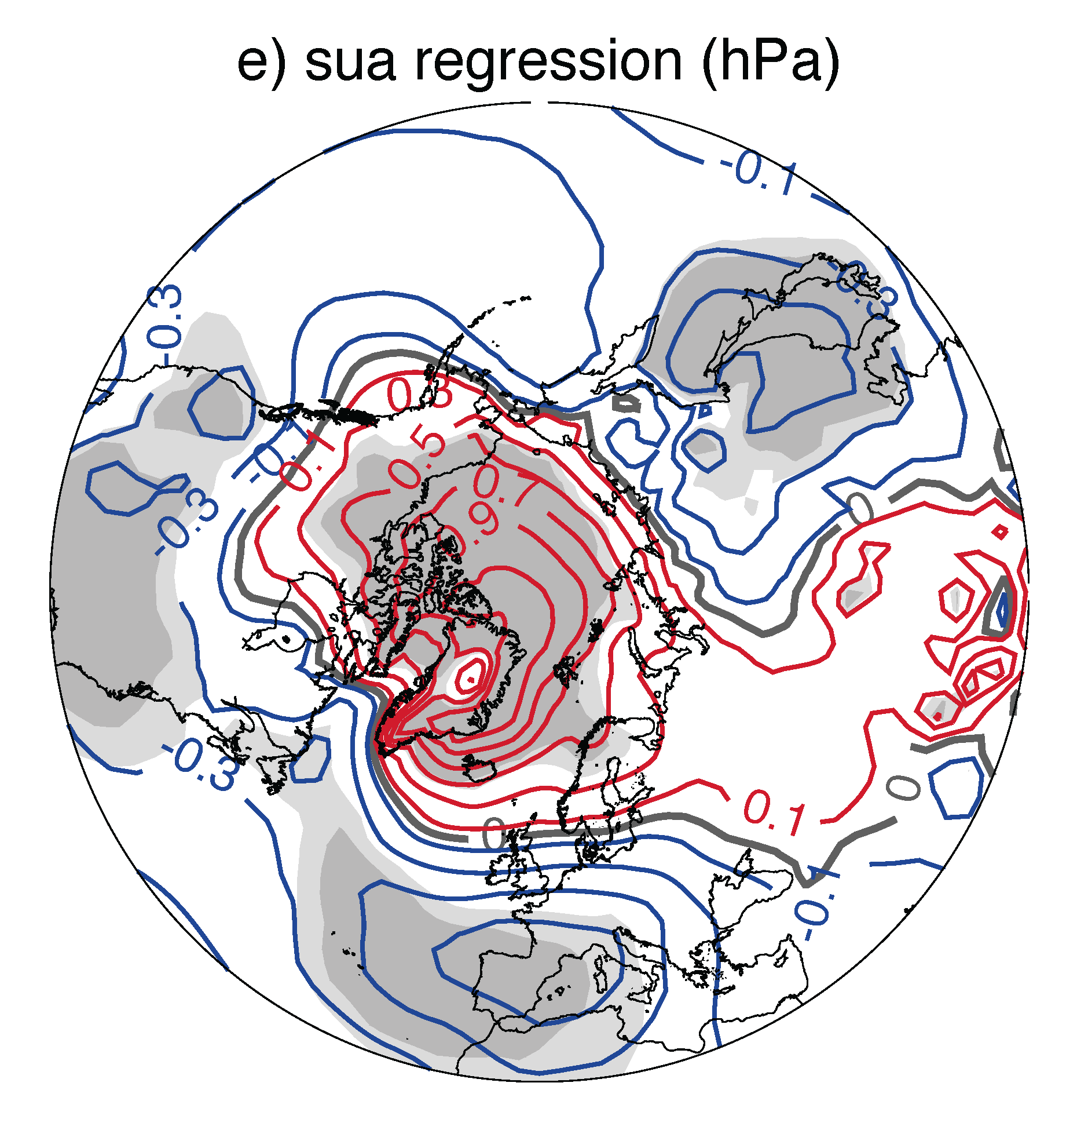


Stratospheric Role in Climate Change Uncertainty
Intermodel regressions with respect to projected polar vortex changes
Zonal Mean Zonal Wind Sea Level Pressure
  ♠ Vertically coherent annular structure with significant extension into troposphere
  ♥ Substantial and statistically significant contribution to Arctic SLP uncertainty
Manzini et al. (2014)

