Slide 1
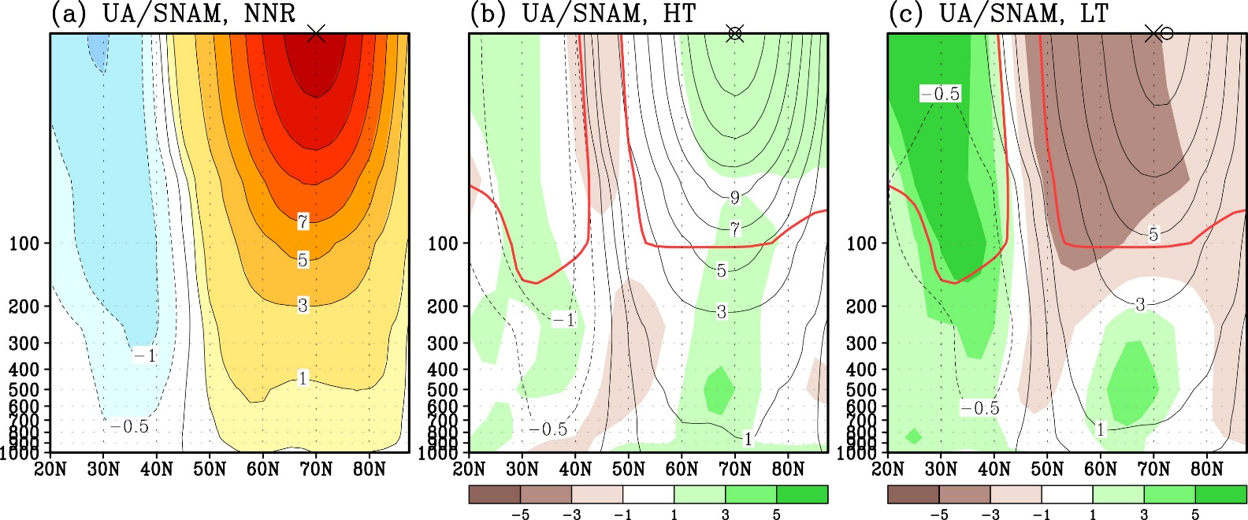
Stratospheric Northern Annular Mode (SNAM) in CMIP5
Zonal-mean zonal wind regressed with respect to SNAM index (contours: Zonal wind anomalies; green/brown shading: Model biases)
Reanalyses High-Top Models Low-Top Models
♠ Low-top CMIP5 models underrepresent SNAM amplitude in stratosphere
♥ Although both high-top and low-top models well represent the zonal-mean tropospheric signature of SNAM, regional patterns are shifted eastward
♣ Upward transmission of tropospheric waves too weak in low-top models
Lee and Black (2015)

