Slide 1
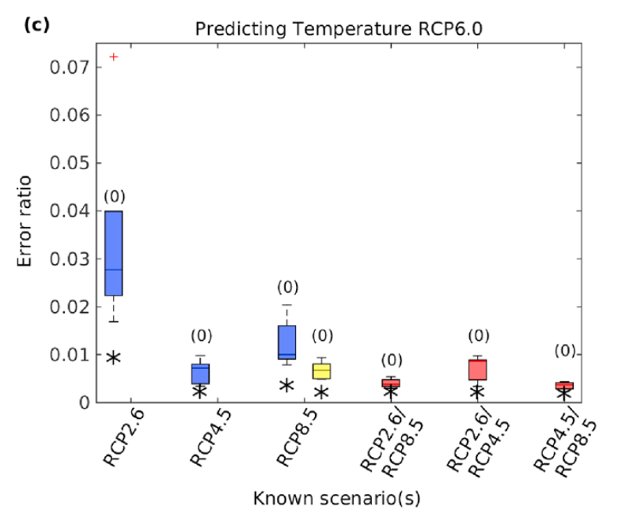
Improved pattern scaling approaches for the use in climate impact studies
Aims
Propose and assess improved pattern scaling methodologies
Method
A first approach considers ‘time-shifting’, where comparable periods of global mean temperature are found in an existing simulation
The second approach uses bivariate predictors of regional climate, using both global mean temperature and land-sea temperature offset
Findings
Both methods were found to produce greater skill than traditional pattern scaling, but are appropriate in different circumstances.
Herger, N., B.M. Sanderson and R. Knutti, 2015, Improved pattern scaling approaches for the use in climate impact studies, Geophysical Research Letters, 2015, doi: 10.1002/2015GL063569, early online

