Slide 1
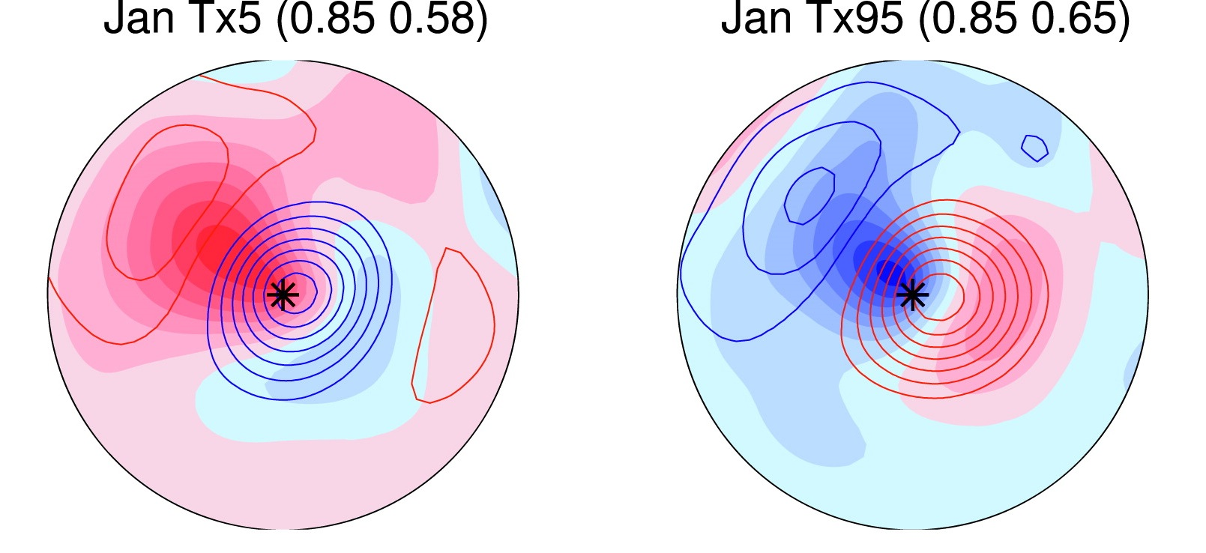
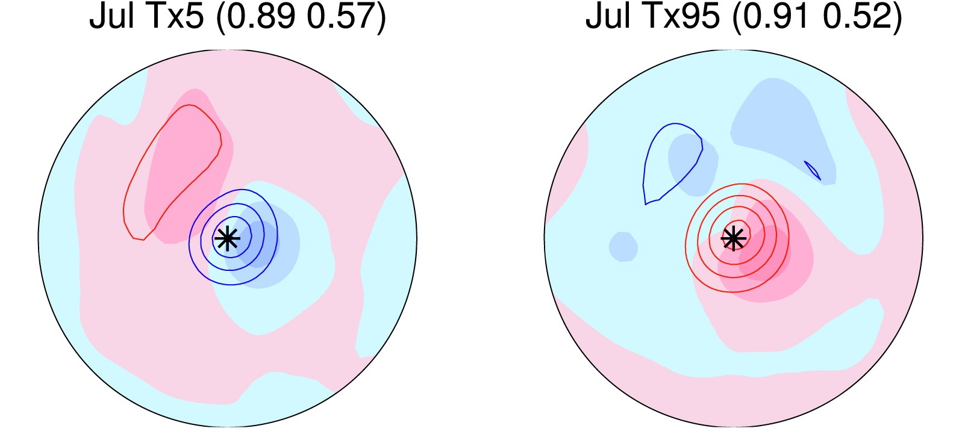
Large-Scale Meteorological Patterns & Temperature Extremes
Anomalies in SLP (shading, hPa) and 500 hPa Z (contours; 20 m interval)
Cold Days January Warm Days Cold Days July Warm Days
♠ Review paper on subseasonal extreme temperature events (ETEs) and the large-scale meteorological patterns (LSMPs) linked to ETEs
♥ Overview of statistics, synoptic & dynamic analyses, and model fidelity
♣ Current knowledge of the behavior and physics of LSMPs incomplete
♦ Need for uniform and objective characterization of LSMP behavior
♠ Need for mechanistic studies of LSMP life cycles and ETE linkages
Grotjahn et al. (2015)

