Slide 1


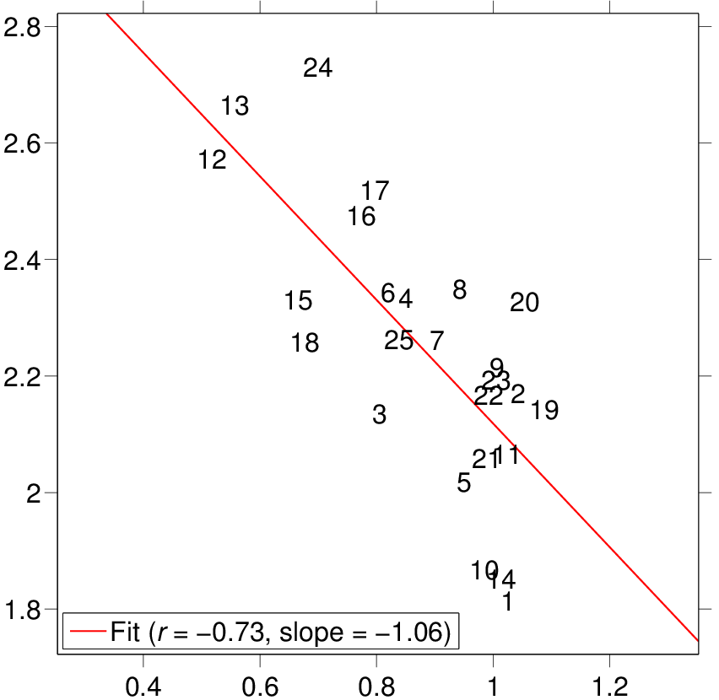
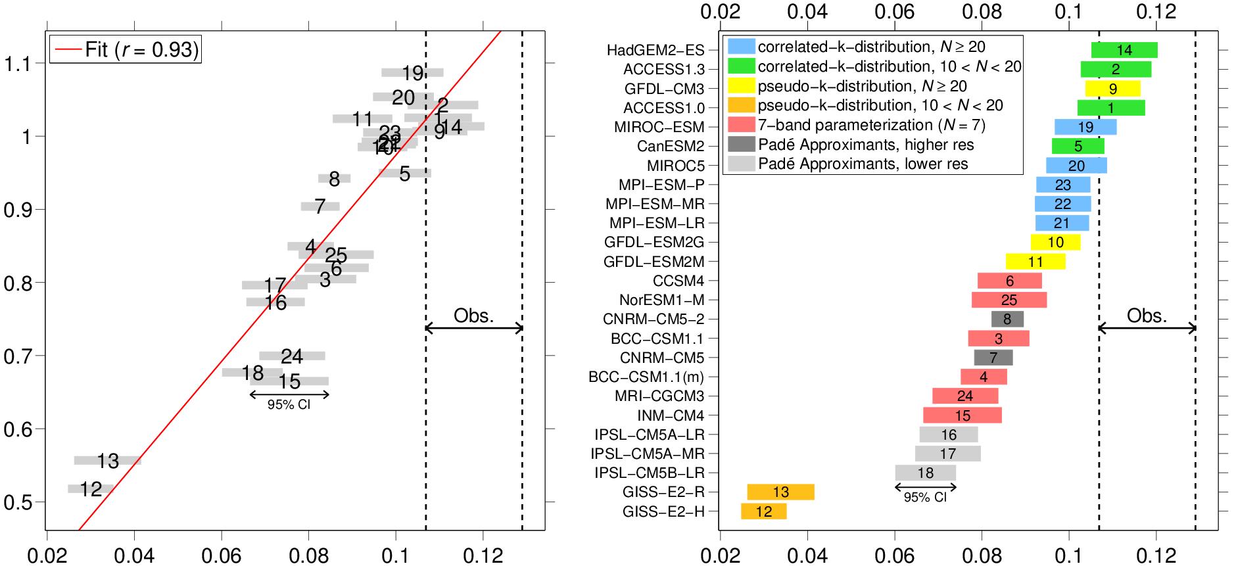
An observational radiative constraint on hydrologic cycle intensification
Anthony M. DeAngelis, Xin Qu, Mark D. Zelinka, Alex Hall
Scientific Question:
Temperature-mediated responses
What causes model spread in projections of global-mean precipitation increase under greenhouse-induced climate change?
Relationship between warming-induced precipitation and shortwave absorption increase
Approach:
L_{v}dP/dT (W/m²/K)
In 25 CMIP5 simulations, we investigate the contributions of the atmospheric energy budget components to the spread.
We analyze the rapid adjustments and temperature-mediated responses of the energy budget components following an abrupt increase in atmospheric carbon dioxide.
Sensitivity of shortwave absorption to variations in atmospheric water vapor
Key Findings:
dSWA/dT (W/m²/K)
Shortwave parameterization schemes
Model differences in the warming-induced increase in atmospheric shortwave absorption from atmospheric moistening generate spread in the precipitation increase.
The sensitivity of atmospheric solar absorption to a unit change in water vapor, which is determined by radiative transfer schemes, explains the model differences.
Based on an observational estimate, models underestimate this sensitivity, thus overestimating the precipitation increase.
Improving parameterizations could reduce the spread and ensemble-mean value of global-mean precipitation increase per unit surface warming by ~35% and ~40%, respectively.
dSWA/dT (W/m²/K)
dSWA/dPW (%/[kg/m²])
dSWA/dPW (%/[kg/m²])
Publication:
DeAngelis, A. M., Qu, X., Zelinka, M. D. & Hall, A. An observational radiative constraint on hydrologic cycle intensification. Nature 528, 249-253, doi: 10.1038/nature15770 (2015).
Notes:
Background: On annual and longer time scales, the global-mean atmospheric energy budget is in balance. Net cooling from longwave radiation is balanced by heating from shortwave absorption, sensible heat flux from the surface to atmosphere, and latent heat release from precipitation. Following an increase in greenhouse gases, these energy sources and sinks readjust due to a direct response to the forcing (including a rapid atmospheric adjustment) and a response that is induced by surface warming that results from the forcing (the temperature-mediated response). In simulations of future climate, models predict an increase in global-mean precipitation (per degree warming) that varies by a factor of three among different models. Our goal is to understand the origins of this spread from the perspective of the atmospheric energy budget.
Figure description: (top) The temperature-mediated response of global-mean precipitation (L_{v}dP/dT) versus that of clear-sky atmospheric shortwave absorption (dSWA/dT) under carbon dioxide forcing. A least-squares linear fit for the scatterplot is shown. Each number represents a different model. In short, models with a larger increase in shortwave absorption per unit warming tend to have a smaller increase in precipitation for the same warming. This makes physical sense, as when climate warms, increases in shortwave absorption will suppress the precipitation increase. This occurs through a reduction of the latent heating increase required to maintain a balanced atmospheric energy budget. (bottom-left) dSWA/dT (as shown in the top panel) versus of the sensitivity of solar absorption to variations in column precipitable water (dSWA/dPW, see Methods below). A linear fit is shown. An observational estimate of dSWA/dPW based on CERES-EBAF fluxes and three water vapor datasets is shown with vertical dashed lines. (bottom-right) The relationship between dSWA/dPW and the parameterization for solar absorption by water vapor in a cloudless atmosphere, with each model colored based on the type of parameterization.
Methods:
1) Temperature-mediated responses and rapid adjustments are separated by applying the Gregory method to simulations in which atmospheric carbon dioxide is abruptly quadrupled. In this method, annual anomalies in the global-mean energy budget components following the carbon dioxide increase are regressed against those in 2-m temperature. The regression slope represents the temperature-mediated response and the y-intercept represents the rapid adjustment.
2) The sensitivity of solar absorption to a unit change in water vapor (dSWA/dPW) is estimated by conditioning clear-sky atmospheric shortwave absorption (normalized by incoming solar flux) on column precipitable water taken from each month and grid cell over the tropical oceans in the pre-industrial climate (or in the case of observations, over the first ~10 years of the 21st century).

