Slide 1




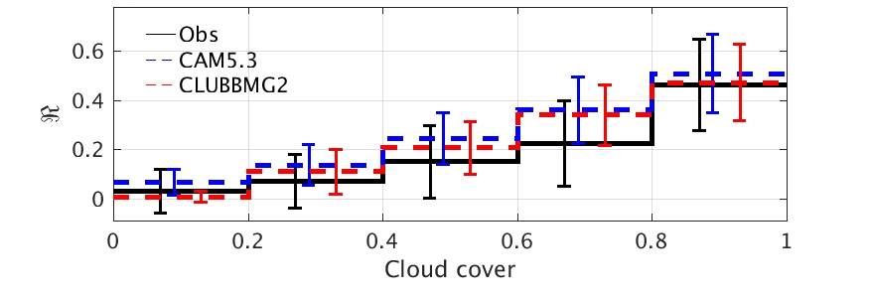
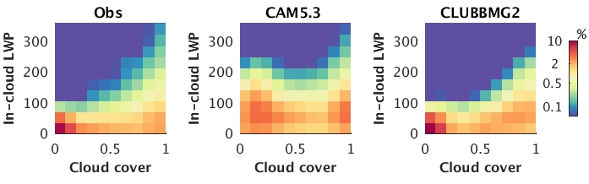
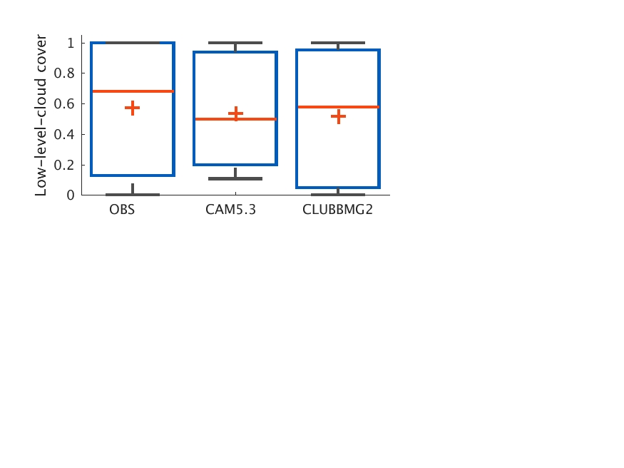
ARM Azores observations help identify deficiencies in climate model simulations of low clouds
Science Question
Does the next generation CAM simulate more realistic cloud structure for different cloud conditions and precipitation?
Does the new CAM version improve the simulation of surface SW cloud radiative effect(CRE) ?
Approach
Use ARM Azores observations to evaluate CAPT simulations of low clouds with different versions of CAM schemes
Key Accomplishment
Identified the low-cloud biases in the different versions of CAM cloud parameterization schemes
Normalized surface CRE
Too bright
Better
In-cloud LWP bias related to the “too bright” issue
Better
Cloud Cover Statistics
CAM5.3: a “too few, too bright” cloud problem
CLUBBMG2: a “not enough” cloud problem
Zheng, X., S. A. Klein, H.-Y. Ma, P. Bogenschutz, A. Gettelman, and V. E. Larson, 2016: Assessment of Marine Boundary Layer Cloud Simulations in the CAM with CLUBB and Updated Microphysics Scheme Based on ARM Observations from the Azores. J. Geophys. Res. Atmos. doi: 10.1002/2016JD025274
Too few
Not enough
Notes:
Figure caption: Top: The normalized surface CRESW R binned by hourly low-level-cloud cover for the observations (black solid lines), CAM5.3 (blue dash lines) and CLUBB-MG2 (red dash lines) during MBL cloud days. The error bars represent one standard deviation of the data. Middle: Joint PDFs (%) binned by hourly low-level-cloud cover and hourly in-cloud LWP (g m⁻²) from the observations, CAM5.3 and CLUBB-MG2. Bottom: Hourly low-level-cloud cover from the observations, and model outputs for MBL cloud days. The bottom and top of each whisker denote the 10th and 90th percentiles, the bottom and top of each box denote the 25th and 75th percentiles, and the cross line and plus sign inside the box indicate the median and the mean values, respectively.
Key Points:
Three versions of CAM short-term hindcasts are performed and compared to ARM observations from the Azores during the CAP-MBL field campaign.
CAM5 with CLUBB and MG2 scheme (CLUBB-MG2) better simulates MBL cloud processes.
CLUBB-MG2 does not improve the surface SW CRE mainly due to its MBL cloud cover biases.

