Slide 1
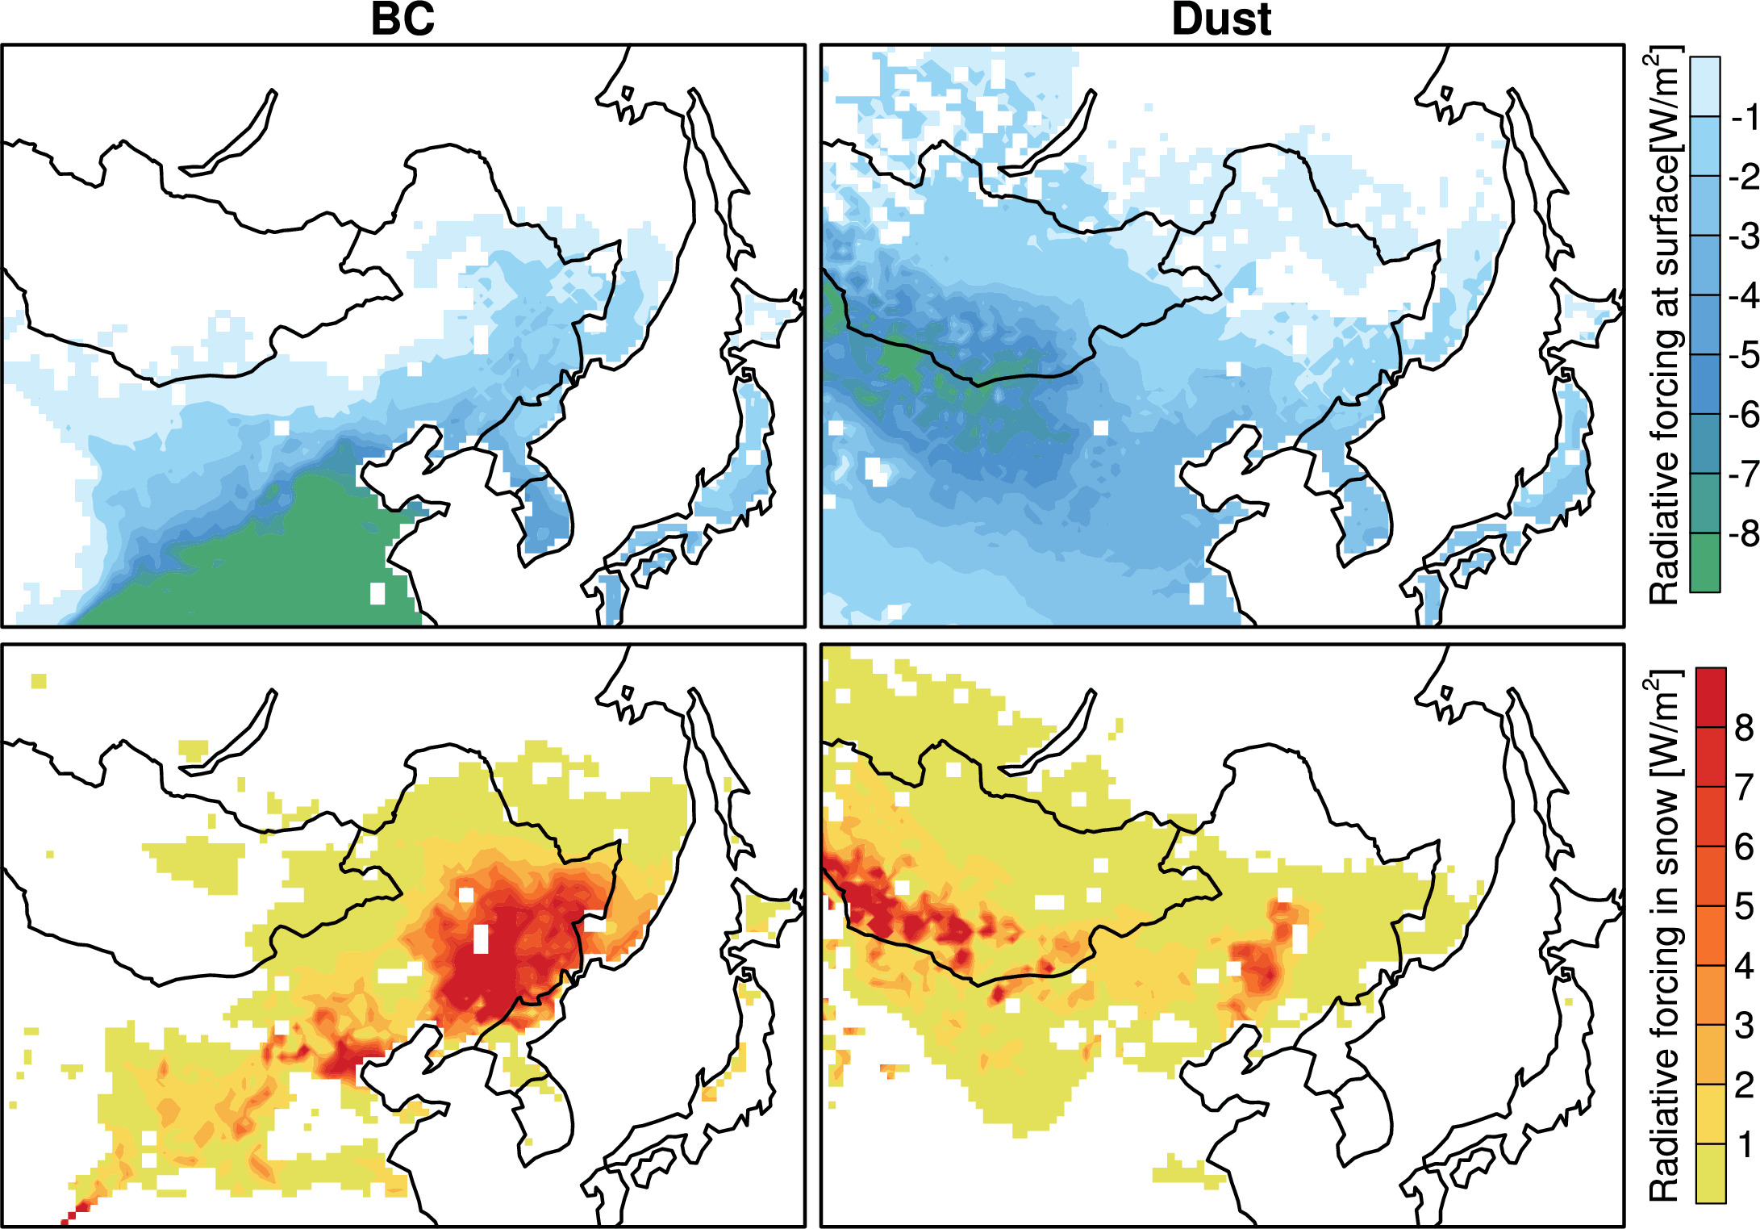
Black Carbon and Dust Radiative Forcing in Seasonal North China Snow
Objective
Develop a regional modeling framework based on WRF-Chem for simulating absorbing aerosols in snowpack
Evaluate simulations at a relatively high spatial resolution against the field campaign measurements
Estimate the radiative forcing of black carbon (BC) and dust in snow over North China
Approach
Couple WRF-Chem with a snow model (SNICAR) in CLM and simulate at 36x36 km² over North China for 2010.01-02
Evaluate simulations with the measurements from a field campaign in North China
Calculate radiative forcing of BC and dust in snowpack
Spatial distribution of BC and dust direct radiative forcing
at the surface and in the snow from the WRF-Chem simulations
over North China in January–February 2010.
Impact
First use of a regional modeling framework to simulate BC and dust and their direct radiative forcing in snowpack shows general consistency with observations
Black carbon and dust in snow introduce a similar magnitude of radiative warming in the snowpack, comparable to the magnitude of surface radiative cooling due to black carbon and dust in the atmosphere
More observations, particularly concurrent measurements of atmospheric and snow aerosols and the deposition fluxes of aerosols, are needed to further reduce model uncertainties in simulating aerosol-snow interaction in future campaigns
Zhao C, Z Hu, Y Qian, R Leung, J Huang, M Huang, J Jin, M Flanner, R Zhang, H Wang, H Yan, Z Lu, and DG Streets. 2014. “Simulating Black Carbon and Dust and their Radiative Forcing in Seasonal Snow: A Case Study over North China with Field Campaign Measurements.” Atmospheric Chemistry and Physics 14: 11475-11491. DOI:10.5194/acp-14-11475-2014
Notes:
http://www.pnnl.gov/science/highlights/highlightsasp?division=749

