Slide 1
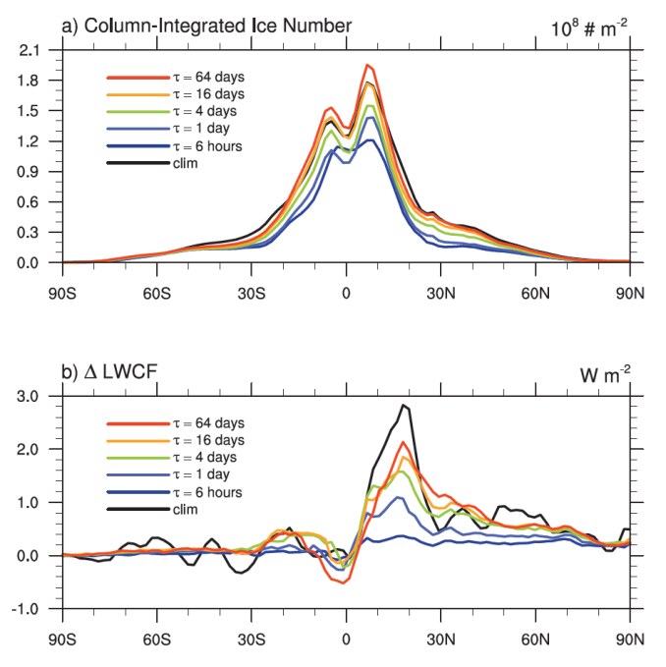
Refined Experimentation Strategy for the Aerosol-Climate Model Intercomparison Project
Objective
Establish a convenient strategy that provides good balance between constraining model meteorology and preserving the model’s mean climate characteristics
Approach
Use the Newtonian relaxation method to nudge simulations toward re-analysis meteorology fields
Use two well-known aerosol-climate models to assess the aerosol indirect effect through ice-clouds
Determine dependence of results on which fields are nudged
Temperature nudging in CAM5 has a large impact on the modeled ice-cloud formation and anthropogenic aerosol indirect effect through ice clouds.
Impact
The new modeling strategy helps climate modelers better identify model biases and understand inter-model discrepancies
New method is adopted in the AeroCom III Aerosol Indirect Effect Experiment to assess the anthropogenic aerosol indirect effect through both warm and cold clouds.
Zhang K, H Wan, X Liu, SJ Ghan, GL Kooperman, P-L Ma, PJ Rasch, D Neubauer, U Lohmann. 2014. “Technical Note: On the Use of Nudging for Aerosol-climate Model Intercomparison Studies.” Atmospheric Chemistry & Physics 14:8631-8645. DOI: 10.5194/acp-14-8631-2014.
Notes:
http://www.pnnl.gov/science/highlights/highlights.asp?division=749

