Slide 1
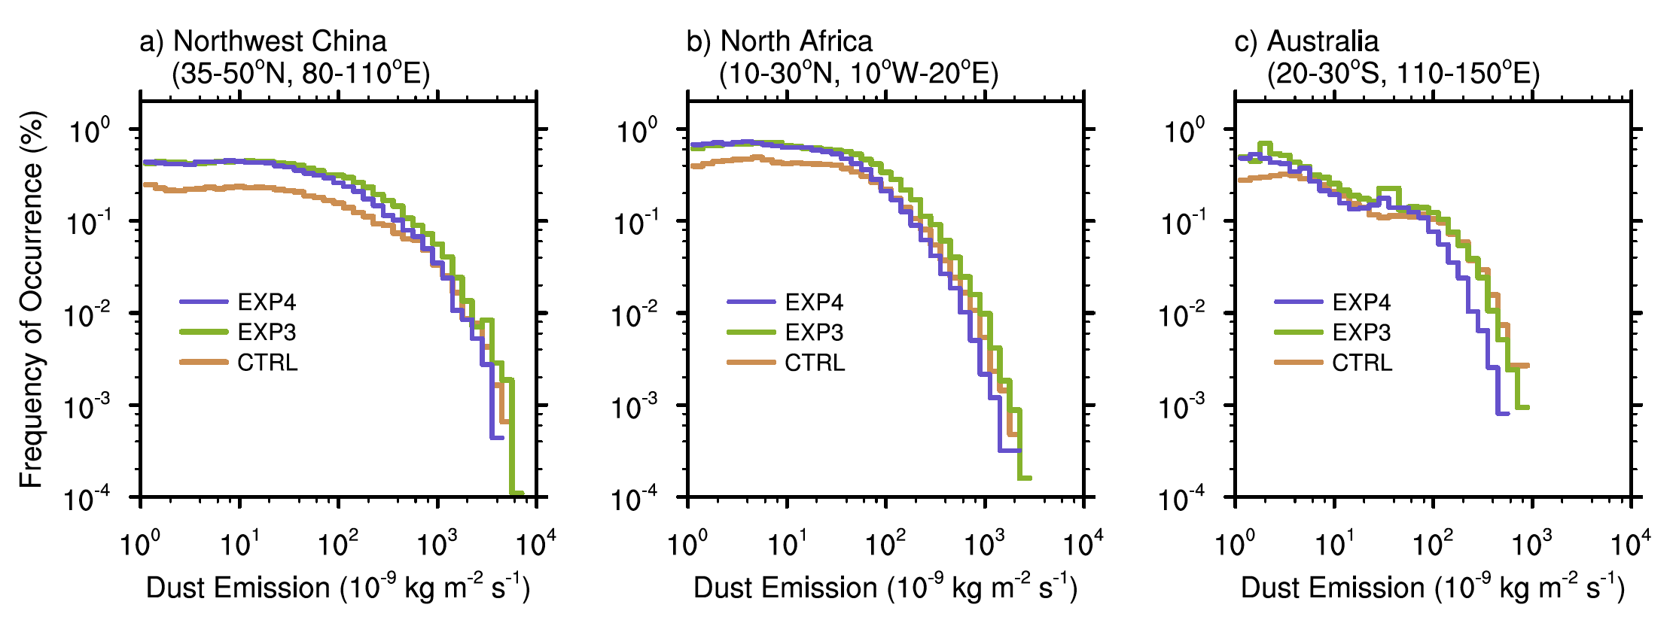
Quantifying the Impact of Sub-grid Surface Wind Variability on Sea Salt and Dust Emissions in CAM5
Objective
Develop a sub-grid treatment for CAM5 to take into account the impact of unresolved variability of surface wind speed on sea salt and dust emissions.
Approach and Results
Approximate the sub-grid PDF of surface wind speed using the Weibull distribution.
Estimate parameters of the Weibull PDF using grid-box mean physical quantitates provided by the global model.
Take multiple wind speed samples of from the estimated Weibull PDF, and calculate emission fluxes with each wind speed sample.
Results show that dry convective eddies and meso-scale flows associated with complex topography can cause strong enhancements in dust emission.
Frequency distribution of dust emission changes when sub-grid wind variability is considered
CTRL: default CAM5; EXP3: with sub-grid wind variability but without re-tuning; EXP4: with sub-grid wind variability and after re-tuning the global mean dust emission
Impact
The new treatment enables a better representation of the nonlinear dependence of emission flux on sub-grid wind speed in CAM5.
Zhang K, Zhao C, Wan H, Qian Y, Easter RC, Ghan SJ, Sakaguchi K, and Liu X. 2016. “Quantifying the Impact of Sub-grid Surface Wind Variability on Sea Salt and Dust Emissions in CAM5.” Geoscientific Model Development 9(2): 607-632. [DOI: 10.5194/gmd9-607-2016]
Notes:
http://www.pnnl.gov/science/highlights/highlights.asp?division=749

