Slide 1
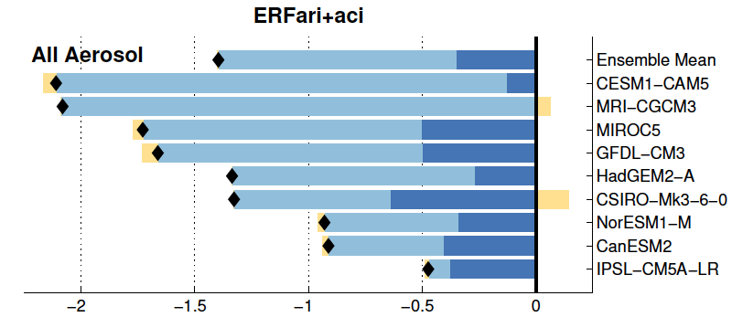
Detailing Aerosol-Cloud-Radiation Interactions using Simple Diagnostics
Objective: To systematically and efficiently diagnose and partition aerosol direct and indirect effects from standard CMIP5 climate model output.
Research: We apply two techniques to diagnose aerosol radiative forcing in aerosol perturbation experiments performed in CMIP5. The ensemble mean total aerosol forcing of -1.40±0.6 Wm⁻² is made up of 25% direct and 75% indirect components. The direct effect arises from -0.62±0.3 Wm⁻² of aerosol scattering opposed by +0.26±0.1 Wm⁻² of aerosol absorption. ERFaci is primarily due to enhanced cloud scattering rather than from changes in cloud amount.
Global and annual mean shortwave aerosol effective radiative forcing for each model, broken down into (dark blue) direct and (light blue) indirect components.
Impact: Aerosol direct and indirect forcings can be systematically computed and partitioned among various contributions using standard climate model output, without the need for sophisticated diagnostics. This facilitates better understanding of the sources of model differences and may aid in comparing aerosol effects on climate between models and observations.
Reference: Zelinka, M. D., T. Andrews, P. M. Forster, and K. E. Taylor, 2014: Quantifying Components of Aerosol-Cloud-Radiation Interactions in Climate Models, J. Geophys. Res., doi: 10.1002/2014JD021710, in press.
Notes:
The interaction of anthropogenic aerosols with radiation and clouds is the largest source of uncertainty in the radiative forcing of the climate during the industrial period. Understanding and quantifying aerosol-radiative interactions and aerosol-cloud interactions has long been hampered by different approaches used by different research groups. Here we show how the effective radiative forcing due to aerosol-radiation interactions (ERFari) and due to aerosol-cloud interactions (ERFaci) can be computed and partitioned among its various contributions using standard climate model output. This facilitates better understanding of the sources of model differences and may aid in comparing aerosol effects on climate between models and observations.
We apply two techniques borrowed from the cloud feedback literature to aerosol perturbation experiments performed in phase 5 of the Coupled Model Intercomparison Project. We find that the ensemble mean shortwave ERFari+aci of -1.40±0.56 Wm⁻² comes roughly 25% from ERFari and 75% from ERFaci. ERFari is made up of -0.62±0.30 Wm⁻² due to aerosol scattering opposed by +0.26±0.12 Wm⁻² due to aerosol absorption, and is largest near emissions sources. The presence of clouds reduces the magnitude and inter-model spread of ERFari by 40-50%, making the change in clear-sky flux a biased proxy for aerosol direct effect. ERFaci, which is large both near and downwind of emission sources, is comprised of -0.99±0.54 Wm⁻² from enhanced cloud scattering, with much smaller contributions from increased cloud amount and absorption. In models that allow aerosols to affect ice clouds, large increases in the optical depth of high clouds cause substantial radiative anomalies in both the longwave and shortwave parts of the spectrum. Inter-model spread in ERFaci is dominated by differences in how aerosols increase cloud scattering, but even if all models agreed on this effect, over a fifth of the spread in ERFaci would remain due solely to differences in total cloud amount.

